Slide 1
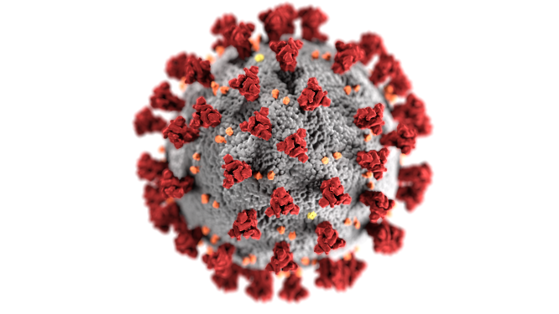
COVID-19 Workplace Safety Training
For small business owners and employees; Summer 2020
Photo: CDC
The Polytechnic School
Environmental & Resource Management Program

Slide 2
Disclaimer and acknowledgements
The information provided in this training is based on current information regarding best practices obtained from guidance and publications issued by the U.S. Centers for Disease Control and Prevention, U.S. Occupational Safety and Health Administration, National Institutes of Environmental Health Sciences (NIEHS), Arizona Department of Health Services (ADHS) as well as other federal, state and local public health officials, as of June 15, 2020.
This training is funded by the NIEHS Worker Training Program. The ASU Environmental & Resource Management Program (ERM) developed this training. ASU thanks the ADHS, Arizona Division of Occupational Safety and Health, Arizona Association of General Contractors, Arizona Public Health Association, Inter Tribal Council of Arizona and the Associated Minority Contractors of Arizona for review and comment on training materials. Special thanks to the ASU Environmental Health and Safety Program for permission to share slides.

Slide 3
This training...
is not intended for health care facilities, and COVID-19 high risk job assignments. It is applicable to medium and low risk workplaces. Personnel must be trained to their employer’s site-specific policies and procedures and job tasks. Training must include practice in putting on and taking off personal protective equipment (PPE) selected by the employer and used at the job site.

Slide 4
Goal:
Increase health and safety awareness for employers and employees
Objectives:
Explain basic facts about COVID-19.
Assess the risk of workplace exposure to COVID-19.
Define key steps in worker protection and infection control.
Identify methods to prevent and respond to COVID-19 exposure in the workplace.
Understand applicable OSHA and ADOSH requirements

Slide 5
Contents
Module 1 COVID-19 Basics
Module 2 Assessing the Potential for Exposure to COVID-19 in the Workplace
Module 3 Methods to Prevent COVID-19 in the Workplace and OSHA Standards

Slide 6
Employer and worker responsibilities
The Occupational Safety and Health Act (OSHA) mandates shared responsibilities for workplace safety/health by both employers and employees.
Employers must provide a safe and healthy workplace free of recognized hazards, including infectious diseases.
Workers should participate in the development and implementation of the employer’s safety and health policies.
Workers have a right to file a complaint with OSHA/ADOSH, the state or local health department and other governmental agencies.
The law prohibits employers from retaliating against a person who files a complaint.

Slide 7

Module 1:
COVID-19 Basics
Notes:
Instructor notes:
Because SARS-CoV-2 is a new virus, information is changing on almost a daily basis. It is very important to check authoritative sources of information to make sure the training material is current. This includes primary sources like the CDC, OSHA, NAID, and peer reviewed journals such as JAMA, NEJM, etc.

Slide 8
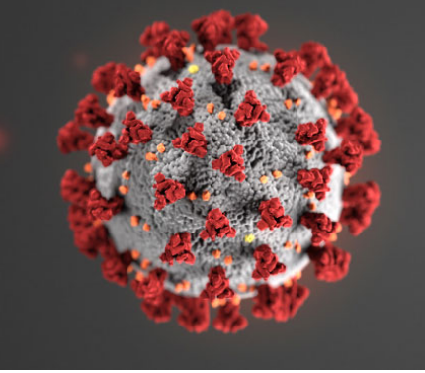
What is SARS-CoV-2?
SARS-CoV-2 is the virus that causes coronavirus disease 2019 (COVID-19)
SARS = severe acute respiratory distress syndrome
Spreads easily person-to-person
Little if any pre-exposure immunity in humans
Detailed information: https://www.cdc.gov/coronavirus/2019-ncov/index.html
Notes:
Instructor notes:
The virus has been named “SARS-CoV-2” and the disease it causes has been named “coronavirus disease 2019” (abbreviated “COVID-19”). Throughout this training we refer to the virus as SARS CoV-2 and the disease as COVID-19.
Coronaviruses are a large family of viruses that are common in people and many different species of animals, including camels, cattle, cats, and bats. Rarely, animal coronaviruses can infect people and then spread between people such as with MERS-CoV, SARS-CoV, and now with this new virus (named SARS-CoV-2).
The SARS-CoV-2 virus is a betacoronavirus, like MERS-CoV and SARS-CoV. All three of these viruses have their origins in bats. The sequences from U.S. patients are similar to the one that China initially posted, suggesting a likely single, recent emergence of this virus from an animal reservoir. (https://www.cdc.gov/coronavirus/2019-nCoV/summary.html)
The SARS-CoV-2 virus is a novel strain, meaning that it is new. As a result, humans have not developed immunity to COVID-19, and therefore can be infected. Acquired immunity is when humans have been exposed or vaccinated previously to an infectious agent. An example is when people have measles in childhood or are vaccinated, they develop antibodies and a certain level of protection.
Early on, many of the patients at the epicenter of the outbreak in Wuhan, Hubei Province, China had some link to a large seafood and live animal market, suggesting animal-to-person spread. Later, a growing number of patients reportedly did not have exposure to animal markets, indicating person-to-person spread. Person-to-person spread was subsequently reported outside Hubei and in countries outside China, including in the United States. Some international destinations now have apparent community spread with the virus that causes COVID-19, as do some parts of the United States. Community spread means some people have been infected and it is not known how or where they became exposed.

Slide 9
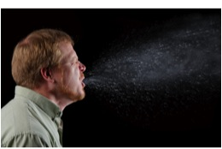
Transmission
COVID-19 is spread from person to person mainly through coughing, sneezing, and possibly talking and breathing.
Droplet - respiratory secretions from coughing or sneezing landing on mucosal surfaces (nose, mouth, and eyes)
  Aerosol - a very small solid particle or liquid droplet suspended in air
Contact -Touching something with SARS-2 virus on it and then touching mouth, nose or eyes
Other possible routes: Through fecal matter
Notes:
Instructor notes:
Spread of SARS-CoV-2, the virus that causes COVID-19, is thought to occur in the same way that seasonal flu spreads. Flu viruses are spread mainly from person to person through coughing or sneezing by people with influenza. We will not fully know how it is transmitted until later when scientists have had time to evaluate it.
Droplet transmission occurs when respiratory secretions from coughing or sneezing land on mucosal surfaces (nose, mouth, and eyes).
Contact transmission is touching something with COVID-19 virus on it and then touching your mouth, nose or eyes.
Aerosol transmission means breathing in infectious COVID-19 particles.
Keep in mind that the virus particles are not visible to the naked eye. The most harmful particles are submicron, shorter than one millionth of a meter.

Slide 10
Transmission
Droplets deposit on surfaces within a few feet, contaminating the surfaces.
Droplets can contact the eyes, nose and mouth of an uninfected person who is within six feet of the infected person.
Aerosols containing the virus can stay suspended in air for hours and travel more than 20 feet.
Some aerosols are less than 2.5 microns and can be inhaled deeply into the lungs
Notes:
See: Reducing transmission of SARS-CoV-2; Prather, K., Wang C., Schooley R., 27 May 2020, Science
https://science.sciencemag.org/content/early/2020/06/02/science.abc6197.1

Slide 11
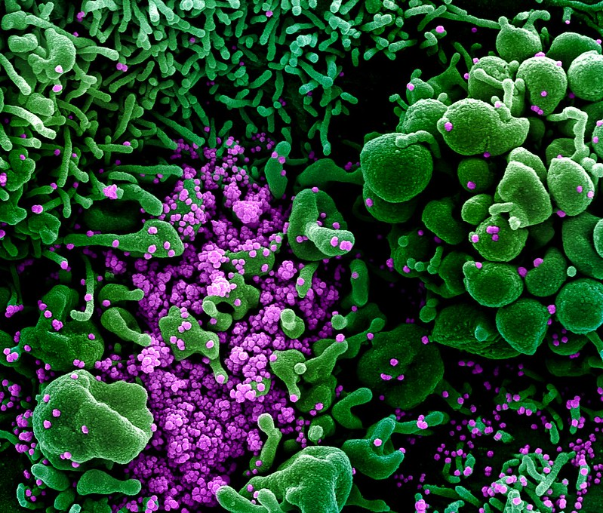
Incubation period
The incubation period is the time between exposure to a virus and the onset of symptoms.
With COVID-19, symptoms may show 2-14 days after exposure.
CDC indicates that people are most contagious when they are the most symptomatic.
But several studies show people are contagious before developing symptoms. The virus can be spread by people who don’t know they are infected.
Photo: National Institute of Allergies and Infectious Diseases
Notes:
Instructor notes:
Most estimates of the incubation period for COVID-19 range from 1-14 days, most commonly around five days. The “incubation period” means the time between catching the virus and beginning to have symptoms of the disease.
This can be longer in some people, especially children and people with weakened immune systems and in people infected with the new COVID-19 virus.
A Johns Hopkins study estimated the median incubation period at 5.1 days ((95% confidence interval [CI], 4.5 to 5.8 days). They found that 97.5% of patients who have symptoms do so within 11.5 days of infection (CI, 8.2 to 15.6 days). https://annals.org/aim/fullarticle/2762808/incubation-period-coronavirus-disease-2019-covid-19-from-publicly-reported
Can someone spread the virus without being sick?
People are thought to be most contagious when they are most symptomatic (the sickest).
Some spread might be possible before people show symptoms; there have been reports of this occurring with this new coronavirus, but this is not thought to be the main way the virus spreads.
CDC: https://www.cdc.gov/coronavirus/2019-ncov/about/transmission.html
Article in medRxiv :
COVID-19 can be spread before it causes symptoms, when it produces symptoms like those of the common cold, and as many as 12 days after recovery, according to a virologic analysis of nine infected patients published on the preprint server medRxiv. https://www.medrxiv.org/content/10.1101/2020.03.07.20032052v1
In a study published in Nature Medicine, the researchers observed the highest viral load in throat swabs at the time of symptom onset, and
inferred that infectiousness peaked on or before symptom onset.
Xi He, Eric H. Y. Lau, et al, Temporal dynamics in viral shedding and transmissibility of COVID-19, Nature Medicine, Brief Communication
https://doi.org/10.1038/s41591-020-0869-5
Led by researchers in Germany, the virologic study, which has not yet been peer-reviewed, found that the novel coronavirus quickly begins producing high viral loads, sheds efficiently, and grows well in the upper respiratory tract (nose, mouth, nasal cavity, and throat).
https://www.medrxiv.org/content/10.1101/2020.03.05.20030502v1.full.pdf
http://www.cidrap.umn.edu/news-perspective/2020/03/study-highlights-ease-spread-covid-19-viruses
Article in JAMA: Air, Surface Environmental, and Personal Protective Equipment Contamination by Severe Acute Respiratory Syndrome Coronavirus 2 (SARS-CoV-2) From a Symptomatic Patient
Citation: Ong SWX, Tan YK, Chia PY, et al. Air, Surface Environmental, and Personal Protective Equipment Contamination by Severe Acute Respiratory Syndrome Coronavirus 2 (SARS-CoV-2) From a Symptomatic Patient. JAMA. Published online March 04, 2020. doi:10.1001/jama.2020.3227

Slide 12
COVID-19 can cause mild to severe symptoms
Most common symptoms include:
Fever
Cough
Shortness of breath
Other symptoms may include:
Sore throat
Runny or stuffy nose
Body aches
Headache
Chills
Fatigue
Gastrointestinal: diarrhea, nausea
Loss of smell and taste
Notes:
Instructor notes:
The symptoms may appear 2-14 days after exposure.
Reports from China have documented that most people experience a mild illness when infected with SARS-CoV-2. However, the same report documented that 16% of the cases had severe illness and about 2.5% resulted in death.
Clinical Characteristics of Coronavirus Disease 2019 in China, NEJM, February 28, 2020 https://www.nejm.org/doi/pdf/10.1056/NEJMoa2002032?articleTools=true

Slide 13
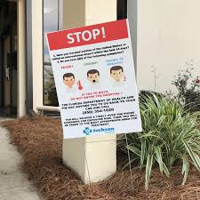
Severe symptoms – emergency warning signs for COVID-19
Most people will have mild symptoms and should recover at home and NOT go to the hospital or emergency room.
Get medical attention immediately if you have:
  Difficulty breathing or shortness of breath.
  Persistent pain or pressure in the chest.
  New confusion or inability to arouse.
  Bluish lips or face.
Notes:
Instructor notes:
Source: https://www.cdc.gov/coronavirus/2019-ncov/symptoms-testing/symptoms.html
This list of severe symptoms is not all inclusive. Please consult your medical provider for any other symptoms that are severe or concerning.
The reason to stay away from emergency rooms, hospitals, and family doctors is to avoid spreading SARS-CoV-2 to others. For most healthy people, the illness will be mild, and you can recover at home by drinking lots of fluids and use of over the counter medications. You should also separate yourself from other people at home and practice good personal and environmental hygiene.

Slide 14
Increased risk of severe illness
COVID-19 poses a greater risk for severe illness for people with underlying health conditions not limited to:
Heart disease
Lung disease such as asthma
Diabetes
Suppressed immune systems
Severe obesity
The elderly have higher rates of severe illness from COVID-19. Children and younger adults have had less severe illness and death. Some children have developed multisystem inflammatory syndrome (MIS-C). The cases are currently under investigation. Because COVID-19 is new, there are a lot of scientific unknowns such as the impact on pregnant women and their fetuses.
Notes:
Instructor notes:
As is the case with seasonal flu, certain conditions appear to put some individuals at increased risk of complications associated with COVID-19. These underlying conditions are listed above.
https://www.cdc.gov/coronavirus/2019-ncov/specific-groups/high-risk-complications.html
Early information out of China, where COVID-19 first started, shows that some people are at higher risk of getting very sick from this illness. This includes:
Older adults and people who have serious chronic medical conditions like:
Heart disease
Diabetes
Lung disease
New information from CDC states that some children have developed multisystem inflammatory syndrome and children with underlying medical conditions and special healthcare needs may be at risk for serious illness. There is much more to be learned about how the disease impacts children.
See: https://www.cdc.gov/coronavirus/2019-ncov/faq.html#COVID-19-and-Children
If you are at higher risk for serious illness from COVID-19 , it is extra important for you to take actions to reduce your risk of getting sick with the disease.
NOTE: The rates of infection may be biased higher for older people because we more easily identify infections with severe illness.

Slide 15
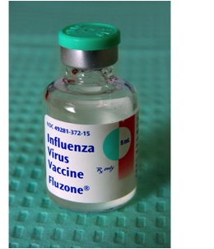
Treatment and vaccines
There is no vaccine to prevent COVID-19.
There is no specific FDA approved medication or treatment for COVID-19.
Treatment is supportive.
People who are mildly ill with COVID-19 should isolate at home during their illness.
Notes:
Instructor notes:
Medical guidelines advise people with mild illness to stay home unless it is an emergency. To reduce the risk of catching or spreading illness, stay home if you feel sick, even if your symptoms are mild. Do not go to work, school or public places, and avoid public transportation. Symptoms should be treated for fever and to prevent dehydration and body aches. Call your health care provider if you develop a high fever, respiratory distress, or other severe symptoms. https://www.cdc.gov/coronavirus/2019-ncov/if-you-are-sick/steps-when-sick.html
If your symptoms are severe or you feel like you need medical care, call before you go to a doctor’s office, urgent care center or emergency room. Describe your symptoms over the phone.
While a vaccine is a central part of the effort to prevent infection and illness, there is no specific antiviral treatment recommended for COVID-19. People with COVID-19 should receive support to help relieve symptoms. For severe cases, treatment should include oxygen supplementation and care to support vital organ functions, as needed.
Unfortunately, viruses such as the coronavirus appear and start spreading before a vaccine is available. With a novel virus, in this case SARS-CoV-2, the population has little or no immunity to the virus.
Even when a vaccine is available, some people will not be vaccinated. Vaccines are tested to ensure that they are safe and effective for most people. However, vaccines normally can have side effects and present significant health risks for vulnerable individuals. Other people who are not considered to be at risk for serious reactions may choose not to receive the vaccine for various reasons.
There is also the possibility that the SARS-CoV-2 virus could mutate, or change over time, which could reduce the vaccine’s ability to prevent infection.
Experimental drugs and vaccines are currently being developed and tested.

Slide 16

Review: What is Wrong with this Picture?
Poor cough etiquette
No cloth face mask
Notes:
Instructor notes:
The CDC recommends that everyone wear cloth face coverings when leaving their homes, regardless of whether they have fever or symptoms of COVID-19. This is because of evidence that people with COVID-19 can spread the disease, even when they don’t have any symptoms. Coronavirus is a unique virus with unique characteristics.
COVID-19 is transmitted by contact, droplets, and fomites. Public health measures, such as hand hygiene and good respiratory etiquette (coughing into your elbow or into a tissue and immediately disposing of the tissue), are important actions all can take to prevent infection.
https://www.who.int/docs/default-source/coronaviruse/situation-reports/20200306-sitrep-46-covid-19.pdf?sfvrsn=96b04adf_2

Slide 17

Module 2:
Assessing the Potential for Exposure to COVID-19 in the Workplace
Notes:
Instructor notes:
In this module we will address potential exposure to the virus, exposure categories and example work settings.

Slide 18
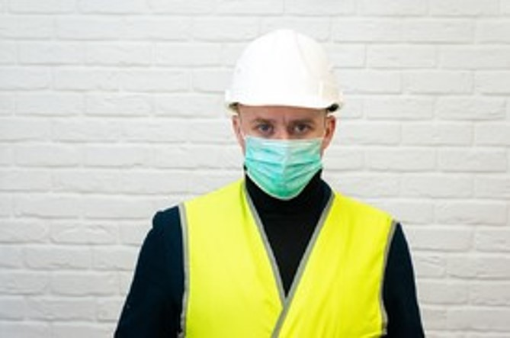
OSHA requires employers to conduct a hazard assessment
The Occupational Health and Safety Act requires employers to provide their employees with a safe workplace
Employers must identify and correct job hazards.
Employers should have a safety and health program in place which includes a plan for preventing and responding to accidents and illnesses at the workplace.
See: 29 CFR 1910.132
Notes:
OSHA published Guidance on Preparing Workplaces for COVID-19 See: https://www.osha.gov/Publications/OSHA3990.pdf

Slide 19
Key exposure factors in the workplace
OSHA has published an occupational risk guide for COVID-19
Does the work setting require close contact with people potentially infected with the COVID-19 virus?
Do specific job duties require close, repeated or extended contact with people with known or suspected COVID-19?
Has the community spread of the virus included cases in the workplace?
Notes:
Instructor notes:
How can you determine if your risk for COVID-19 is greater where you work than in the general population? First, consider whether the type of setting you work in requires close proximity to people potentially infected with the COVID-19 virus. Next, ask whether your specific job duties require you to have either repeated, extended or close contact with known or suspected sources of the virus.
For example, a hospital is a work setting where there will be a greater concentration of individuals who have or are suspected of having the coronavirus.
However, employees who work in the same facility have different risks depending on what part of the institution they work in and the tasks that they perform. Staff who provide bedside care to a patient with COVID-19 have a higher risk of becoming infected at work than someone working in the billing office.

Slide 20
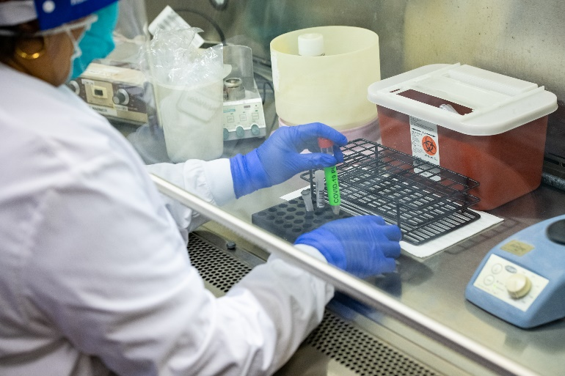
High potential for exposure
High exposure risk occupations are those working with people with known or suspected COVID-19, especially while performing aerosol generating procedures.
Examples of work settings
health care
laboratories
autopsy suites
Examples of job activities
bronchoscopy
sputum induction
working with specimens in laboratories
some dental procedures
some autopsy procedures
Notes:
Instructor notes:
Photo: Stanford.edu
High potential exposure occupations are those with high potential exposure to high concentrations of known or suspected sources of COVID-19 during specific medical or laboratory procedures. High concentrations of coronavirus could result from activities that generate aerosols from known or suspected sources. An aerosol is a spray or mist that is made up of solid or liquid particles.
Examples of work procedures that can produce aerosols that could contain COVID-19 or other coronavirus particles include:
Bronchoscopy
Sputum induction
Working with specimens in laboratories
Some dental procedures
Some autopsy procedures
Keep in mind that the very high risk category only applies to staff who are close to the coronavirus source.
NOTE: OSHA has published a guidance document that has four different exposure categories: very high exposure, high exposure, medium exposure, and low exposure. The OSHA document: https://www.osha.gov/Publications/OSHA3990.pdf

Slide 21
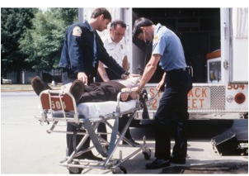
High potential for exposure
Examples of work settings
hospitals and other types of health care facilities
medical transport
correctional facilities
drug treatment centers
homeless shelters
home health care
environmental clean-up of SARS-CoV-2
Examples of job activities
direct patient care
emergency medical services
housekeeping and maintenance in patient areas
Notes:
Instructor notes:
High exposure potential occupations are those with high potential for exposure to known or suspected sources of coronavirus.
Jobs that fall into this category include:
Health care delivery and support staff who are exposed to known or suspected COVID-10 patients. For example, doctors, nurses, and other hospital staff that must enter patients' rooms.
Medical transport of known or suspected patients in enclosed vehicles, such as emergency medical technicians.
Job duties considered at high risk for COVID-19 could take place outside of a health care facility. For example, staff who treat inmates with or suspected of having COVID-19 within a prison health setting would have a risk similar to those caring for patients in a hospital. If the correctional facility refers sick inmates to another facility, staff involved in transporting the prisoners would be performing a medical transport function.
High exposure potential includes environmental clean-up workers assigned to clean and disinfect buildings and other locations, equipment, and materials where known cases of COVID-19 have been present.
CDC has identified other work settings with an elevated risk for exposure including meat and poultry processing plants and congregate settings such as long-term care facilities, and nursing homes .Refer to specific CDC guidance for workplace safety at:
https://www.cdc.gov/coronavirus/2019-ncov/php/homeless-service-providers.html
https://www.cdc.gov/coronavirus/2019-ncov/community/homeless-shelters/plan-prepare-respond.html
https://www.cdc.gov/coronavirus/2019-ncov/hcp/long-term-care-strategies.html
https://www.cdc.gov/coronavirus/2019-ncov/community/organizations/meat-poultry-processing-workers-employers.html

Slide 22

Medium potential for exposure
Examples of work settings
Retail stores
Public transportation
Home visiting occupations
Postal and warehouse workers
Public services
Examples of job activities
Stocking shelves
Checking out customers
Emergency home repairs
Handling mail and goods
Processing public benefits
Notes:
Instructor notes:
Medium potential for exposure occupations are those that have public contact or contact with materials, equipment, or surfaces that may be contaminated. This category reflects an understanding that the virus may be transmitted by people who have no symptoms. Some people with symptoms may also ignore public health warnings about self-isolating or may have little or no support for obtaining necessary goods and services.
Photo by Al Brown

Slide 23
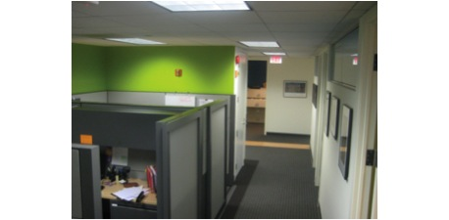
Low potential for exposure
Low potential for exposure occupations are those that do not require contact with people known to be infected nor frequent contact with the public.
Notes:
Instructor notes:
Low potential exposure occupations are those that do not require contact with people known to be infected with the coronavirus, nor frequent close contact with the public, for example office workers or construction workers. However, in communities with widespread infection, any congregate setting may be affected.

Slide 24
Review
Can a workplace exposure change from low to medium exposure or vice-versa?
Yes
Give an example.
An office with administrative controls in place such as no in-person staff meetings begins conducting meetings in the conference room during the pandemic.

Slide 25
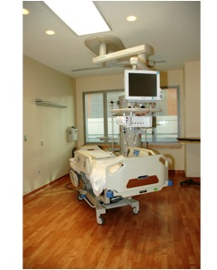
Module 3:
Methods to Prevent COVID-19 in the Workplace and OSHA standards
Notes:
Instructor notes:
In this module we address workplace preparedness, the impact of the pandemic on workers and their families, basic hygiene and social distancing, key elements of a workplace plan, relevant OSHA standards, decontamination, use of PPE and respirators and key prevention methods.

Slide 26


Key steps for preparing for and managing epidemics in the workplace
Preparing for the threat.
Implementing preventive measures.
Implementing the continuity of operations plan.
Managing business recovery post-epidemic.
Notes:
Instructor notes:
All employers should develop written disaster plans with input from all workplace stakeholders. These plans should be reviewed and modified based on knowledge of current threats and lessons learned during previous disasters.
CDC, Get Your Workplace Ready for Pandemic Flu, 2017, https://www.cdc.gov/nonpharmaceutical-interventions/pdf/gr-pan-flu-work-set.pdf
OSHA, Guidance on Preparing for an Influenza Pandemic, OSHA 3327-02N 2007, https://www.osha.gov/Publications/OSHA3327pandemic.pdf
OSHA, Guidance on Preparing Workplaces for COVID-19, OSHA 3990-03 2020, https://www.osha.gov/Publications/OSHA3990.pdf
Although details on preparedness and response are beyond this brief awareness training, the sites above have excellent guidance on these subjects.

Slide 27
Consider the impact on workers
Will a worker be paid if their workplace shuts down or they are quarantined?
What can be done for workers who are sick but have no paid sick leave?
How can workers cope with the impact if their child’s school is shut down or their child is placed in quarantine?
What can be done for low wage and immigrant workers who have no access to health care?
Other impacts?
Notes:
Instructor notes:
Each state has its own workers’ compensation law. This may be relevant if a worker is exposed to SARS-CoV-2 and made ill on-the-job.
Several states have already modified their workers’ compensation systems to presume that certain workers who have COVID-19 got it on-the-job, such as health care, EMS, and law enforcement. Alaska, Minnesota, and Illinois are among the states making this change.

Slide 28

Basic hygiene and social distancing
Stay home when sick.
Wash hands or use sanitizer frequently and after coughing, sneezing, blowing nose, and using the restroom.
Avoid touching your nose, mouth, and eyes.
Cover coughs and sneezes with tissues or do it in your sleeve.
Dispose of tissues in no-touch bins.
Avoid close contact with coworkers and customers (6 feet)
Avoid shaking hands/wash hands after physical contact with others.
Notes:
Instructor notes:
Regardless of exposure potential, there are several steps that everyone can take to lower the chances of becoming sick or spreading COVID-19 at work.
Stay home if you are sick.
Wash your hands frequently with soap and water for 20 seconds or use hand sanitizer if soap and water are not available.
Avoid touching your nose, mouth, and eyes.
Cover your coughs and sneezes with a tissue, or cough and sneeze into your upper sleeve.
Dispose of tissues in no-touch trash receptacles.
Wash your hands or use a hand sanitizer after coughing, sneezing, or blowing your nose.
Avoid close contact with coworkers and customers.
Avoid shaking hands and always wash your hands after physical contact with others.

Slide 29

STOP shaking hands!
Notes:
Instructor notes:
You can greet someone and still maintain social distance of six feet or more.
Image courtesy of NUS University of Singapore, Yong Loo Lin School of Medicine

Slide 30
Prevention in all work settings
Wash hands after removing gloves or when soiled.
Keep common surfaces such as telephones, keyboards clean.
Avoid sharing equipment if possible.
Minimize group meetings by using phone, email, and avoid close contact when meetings are necessary.
Consider telework.
Limit unnecessary visitors to the workplace.
Maintain your physical and emotional health with rest, diet, exercise, and relaxation.
Notes:
Instructor notes:
In general, sharing of PPE is not advised as it can spread contamination and compromise the fit and effectiveness of the equipment.
https://www.fda.gov/medical-devices/personal-protective-equipment-infection-control/questions-about-personal-protective-equipment-ppe

Slide 31
Five steps to proper handwashing
Wet your hands with clean, running water (warm or cold), turn off the tap, and apply soap.
Lather your hands by rubbing them together with the soap. Lather the backs of your hands, between your fingers, and under your nails.
Scrub your hands for at least 20 seconds. Need a timer? Hum the “Happy Birthday” song from beginning to end twice.
Rinse your hands well under clean, running water.
Dry your hands using a clean towel or air dry them.
Notes:
Instructor notes:
Handwashing is important because germs such as virus, get onto your hands when you cough, sneeze, blow the nose, shake hands, use the toilet, and touch surfaces touched by other people. The germs are easily transferred into your body by touching your eyes, nose, and mouth.
CDC: When and How to Wash Your Hands, https://www.cdc.gov/handwashing/when-how-handwashing.html
Activity: Ask the participants if anyone is having a birthday today? Then ask the participants to dry wash their hands while singing happy birthday twice to that participant.
The next slide has an optional 1:25 second video from Johns Hopkins University demonstrating proper handwashing.

Slide 32

Hand washing steps
Notes:
Instructor notes:
Johns Hopkins University video “Hand Washing Steps, Using the World Health Organization Technique”.
This is an optional video that runs for 1 minute and 25 seconds.
Note: the use of the video is optional, depending on time available to conduct the training.

Slide 33
Decontamination
Employers should develop site specific decontamination procedures.
Depending on the workplace, decontamination may require consultation with the health department or use of a consultant specializing in environmental cleanup.
Use of an EPA registered disinfectant is recommended.
Worker and building occupant protection is essential to protect against the virus and adverse effects of the disinfectant.
EPA List: https://www.epa.gov/pesticide-registration/list-n-disinfectants-use-against-sars-cov-2
Notes:
Instructor notes:
The CDC guidelines for health care include disinfecting immediately any visibly contaminated PPE surfaces, equipment, or patient care area surfaces using an EPA-registered disinfectant wipe. They also recommend performing regular cleaning and disinfection of patient care area surfaces, even absent visible contamination. They state that this should be performed only by nurses or physicians as part of patient care activities in order to limit the number of additional health care workers who enter the room.
Decontamination procedures are specific to the industry, job task, and work site. Decontamination is critical because workers can become contaminated with infectious material while taking off PPE and respirators.
Use Products with Emerging Viral Pathogens AND Human Coronavirus claims for use against SARS-CoV-2. Although there is little info on the effectiveness of disinfectants on SARS-CoV-2; however, disinfectants effective against other coronaviruses should be effective for SARS-CoV-2 so use the appropriate EPA-registered disinfectants. See: https://www.epa.gov/pesticide-registration/list-n-disinfectants-use-against-sars-cov-2
CDC guidelines for household settings: https://www.cdc.gov/coronavirus/2019-ncov/community/home/cleaning-disinfection.html#routine-cleaning
Cleaning refers to the removal of germs, dirt, and impurities from surfaces. Cleaning does not kill germs, but by removing them, it lowers their numbers and the risk of spreading infection.
Disinfecting refers to using chemicals to kill germs on surfaces. This process does not necessarily clean dirty surfaces or remove germs, but by killing germs on a surface after cleaning, it can further lower the risk of spreading infection.

Slide 34
OSHA Hazard Communication standard
The hazard communication standard, 29 CFR 1910.1200, establishes a worker’s right to know about chemicals in the workplace
Employers are required to develop and provide:
List of all hazardous chemicals in the workplace
Labels on containers must include required information
Chemical information (safety data sheets)
Training
Written program and worker access to information
Workers using cleaning and disinfecting chemicals must be informed and trained.
Notes:
Instructor notes:
Workers who use chemicals for cleaning and disinfection must understand the hazards of using these substances. OSHA’s Hazard Communication Standard, 1910.1200, requires employers to:
Maintain a list of all hazardous chemicals in the workplace.
Ensure all chemical containers are labeled as required (pictograms, hazard statement, etc.)
Obtain and make available chemical information sheets (safety data sheets) for all hazardous chemicals in the workplace.
Provide training to workers on hazardous chemicals, and
Develop and implement a written program on how to inform workers of hazardous chemicals in each of their workplaces.

Slide 35
COVID-19 workplace plan: Key elements:
Management leadership and employee participation
Hazard identification and assessment
Hazard prevention and control
Risk communication, education, and training
System evaluation and improvement
Family preparedness
Emergency operations procedures
Post pandemic recovery
Notes:
Instructor notes:
Planning and preparation for COVID-19 should be integrated into existing safety and health systems and emergency plans. Elements of an effective program include but are not limited to those listed above.
Maintain flexibility so the COVID-19 plan can be modified in the event of a pandemic with “increased severity.”
System evaluation and improvement refers to organizational policies and procedures relevant to the COVID-19 workplace plan. For example, during an outbreak when a worker is absent due to respiratory illness, the employer’s absentee policy should be relaxed by not requiring a doctor’s note. The CDC has made this recommendation because they are advising people with low level symptoms NOT to go to the hospital emergency room unless they have severe symptoms.
CDC Interim Guidance for Businesses and Employers: https://www.cdc.gov/coronavirus/2019-ncov/community/guidance-business-response.html?CDC_AA_refVal=https%3A%2F%2Fwww.cdc.gov%2Fcoronavirus%2F2019-ncov%2Fspecific-groups%2Fguidance-business-response.html
Family preparedness is instrumental to ensuring that a healthy staff is available and prepared to work during a pandemic. Organizations should try to identify and assess how the impact of school/daycare/adult care closures and other employee needs may impact the availability of employees during a pandemic.
National Academy of Sciences, Engineering and Medicine: A Guide for Public Transportation Pandemic Planning and Response
http://nap.edu/22414

Slide 36
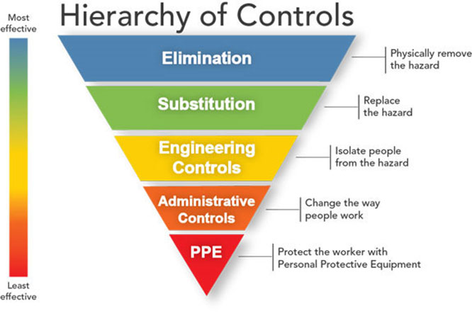
Protecting workers
Start with the most effective method to protect workers.
Physically remove the hazard
Replace the hazard
Isolate people from the hazard
Change the way people work
Protect the worker with Personal Protective Equipment
Notes:
Instructor notes:
As with most any hazard, there are a variety of steps that can reduce or in some cases even eliminate workers’ exposure. A basic principle of workplace safety is to use a combination of strategies to protect workers, starting with the most effective. This approach of moving from most effective to least effective protective measures is called the ‘hierarchy of controls.’
The order of controls, from most effective to least effective is:
Elimination
Substitution
Engineering controls
Administrative Controls & Work practices
Personal protective equipment
Source: NIOSH/CDC https://www.cdc.gov/niosh/topics/hierarchy/default.html
This webpage also provides a more thorough definition of each type of control measure.
Transition: We will now review the overall process for selection and implementation of safeguards and review a few measures that should be used in all workplaces.

Slide 37
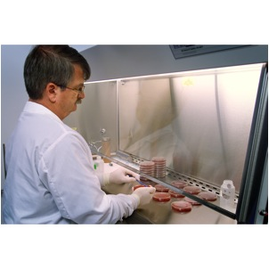
Engineering controls
Ventilation
Drive-thru service
Plastic shields and other barriers
Sneeze guards
Notes:
Instructor notes:
Engineering controls involve making changes to the work environment to reduce work-related hazards. These types of controls are preferred over others because they make permanent changes that reduce exposure to hazards and do not rely on worker or customer behavior. By reducing a hazard in the workplace, engineering controls are not only the most effective, but can also be the most cost-effective solutions for employers to implement.
Examples of engineering controls include:
Using specialized ventilation to remove hazards from the air.
Installing physical barriers, such as clear plastic sneeze guards.
Installing a drive-through window for customer service.

Slide 38

What are examples of engineering controls for COVID-19?
Desks or workstations are at least 6 feet apart.
Barriers are in place to achieve social distancing.
Increased general ventilation.
Electronic pre-payment of goods and services.
Notes:
Instructor notes:
Ask participants to list examples of engineering controls and then review the list.
Engineering controls should be selected based on the features of each specific workplace. They need to be tailored to workplace conditions.
Photo by Karen Berman. Online ordering with curbside service keeps customers out of the store.

Slide 39
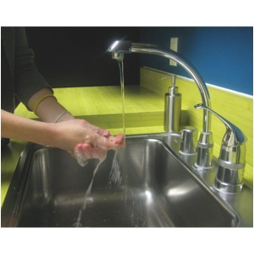
Administrative controls and work practices to reduce exposure
Enable sick workers to stay home
Establish work from home policy
Minimizing contact among workers and clients
Discontinue non-essential travel
Limiting the number of staff present for high potential exposure tasks
Training
Notes:
Instructor notes:
Administrative controls include work practices and procedures to reduce the length, frequency or intensity of exposure to a hazard. Employers should:
Provide resources and a work environment that promotes personal hygiene. For example, supply tissues, no-touch trash cans, hand soap, hand sanitizer, disinfectants, and disposable towels for workers to clean their work surfaces.
Develop procedures to minimize contacts between workers and between workers and patients, clients or customers.
Limit the number of staff present for high exposure tasks such as aerosol generating procedures or entering patient room.
Provide workers with up-to-date education and training on coronavirus risk factors, and methods to prevent exposure.

Slide 40
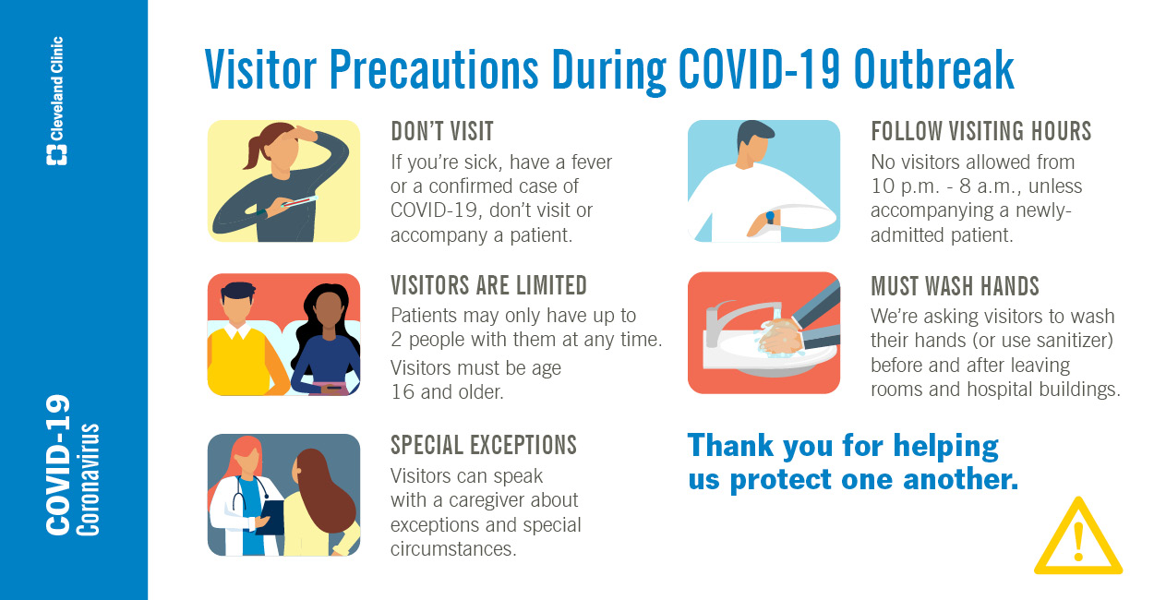
Additional administrative controls
Soft barriers include use of tables, ropes, signs, and floor markings to maintain social distancing.
Notes:
Instructor notes:
The signage lists visitor precautions. Other administrative control examples are use of table, ropes, and floor markings to maintain social distancing.

Slide 41

Adjust employer policies to reduce exposures
Use temperature/symptom checks before coming to work.
Conduct temperature checks when employees arrive to work.
Use email, phone, teleconferences instead of face-to-face contact.
Notes:
Instructor notes:
Adjustments in workplace policies can also reduce exposures.
Enabling ill workers to stay at home without fear of any reprisals.
Discontinuing nonessential travel to locations having high prevalence of illness.
Using e-mail, websites and teleconferences to minimizing face-to-face contact between workers. Where possible, encourage flexible work arrangements such as telecommuting or flexible work hours to reduce the number of workers who must be at the work site at one time or in one specific location.
Relying on home delivery of goods and services to reduce the number of clients or customers who must visit your workplace.
Developing emergency communications plans. Maintain a forum for answering workers' concerns and develop Internet-based communications, if feasible.
Provide education and training materials in an easy to understand format and in the appropriate language and literacy level for all employees.

Slide 42
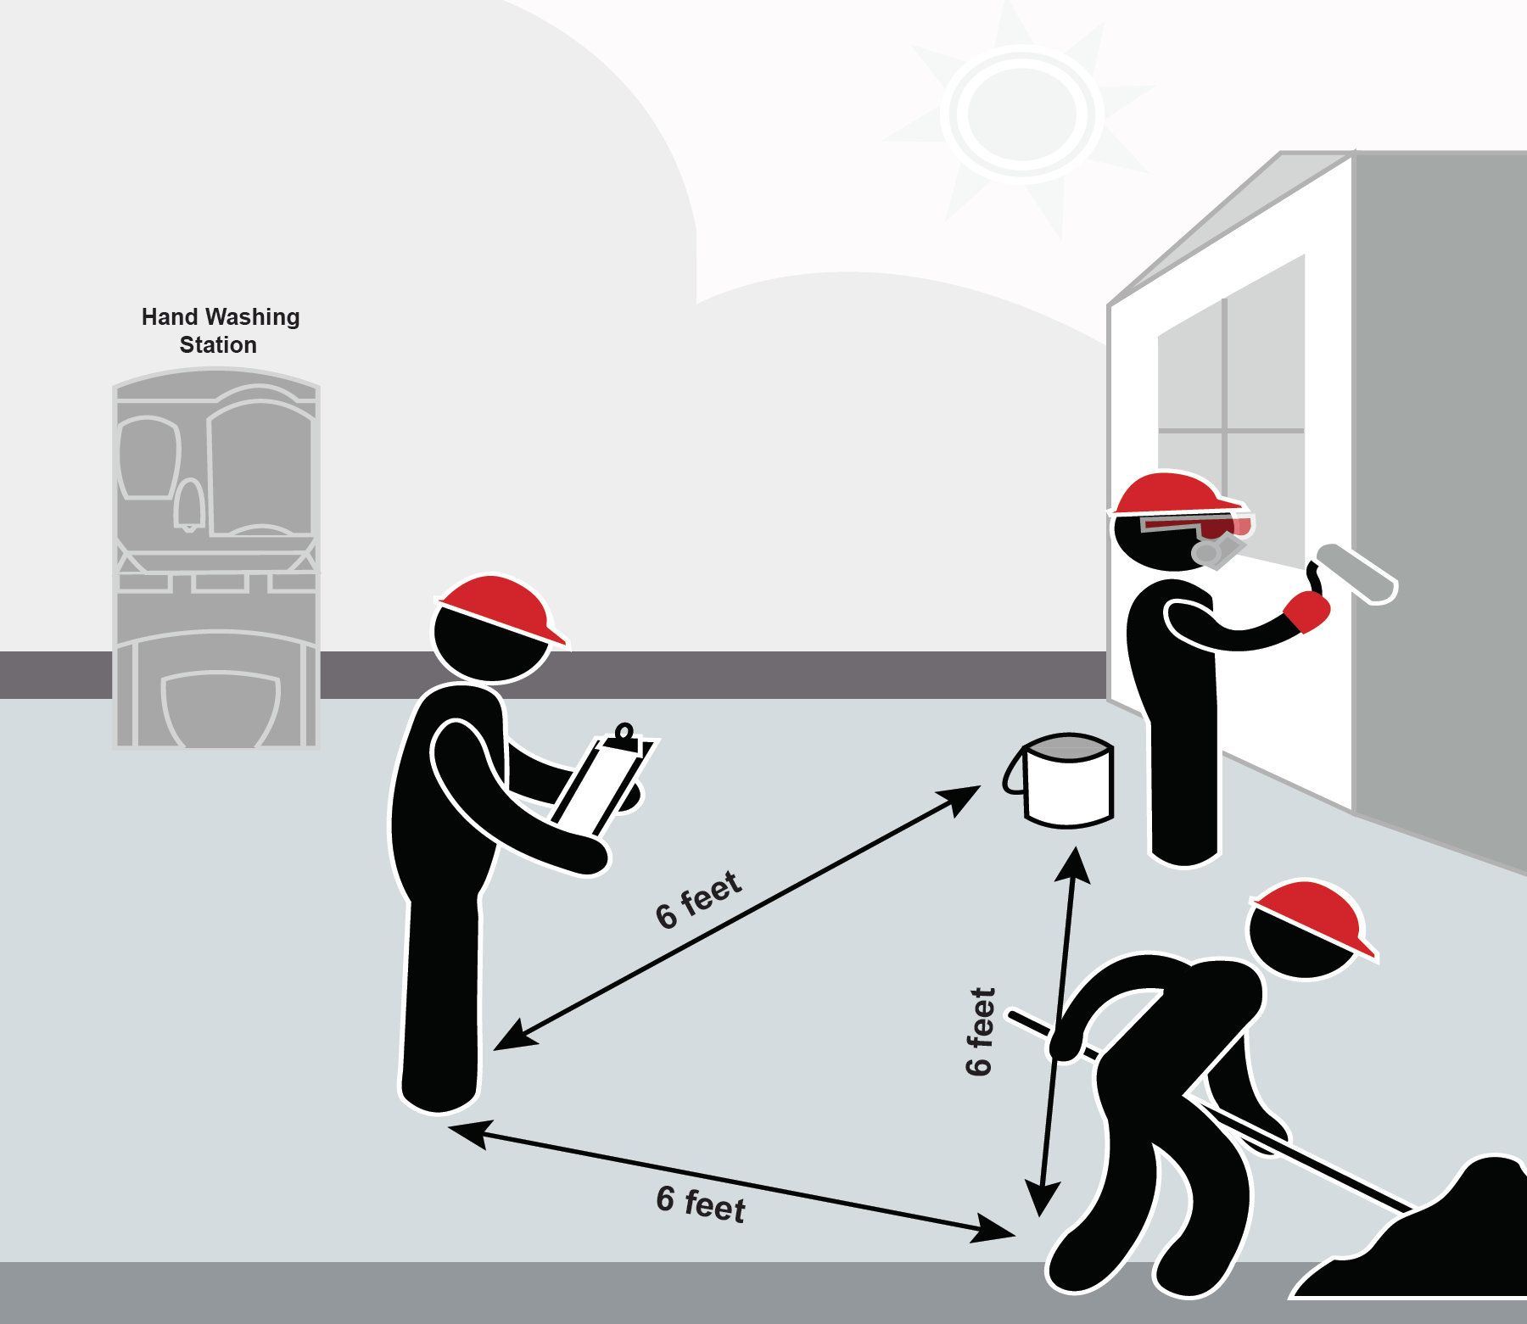
Identify choke points
Identify choke points where workers are forced to stand together, such as hallways, hoists and elevators, break areas, and buses, and control them so social distancing is maintained.
Notes:
Instructor notes:
Choke points interfere with maintaining 6 feet of social distancing. Both employers and workers have a responsibility for identifying choke points and producing methods to eliminate them. Relying on memory alone is NOT a good approach. Use of pedestrian barriers, signs, floor markings etc. to maintain distance between people should be used. Reduce the number of persons per elevator ride. When choke points can’t be eliminated, a higher level of protection should be provided by the employer such as requiring face coverings.
Activity: Ask participants to provide examples of choke points in their employment and describe possible solutions.

Slide 43

OSHA PPE standard
OSHA rules require employers to conduct a workplace hazard assessment to determine if PPE is needed. If the assessment concludes PPE is needed for some job tasks, the employer must:
  Provide PPE at no cost, appropriate to the hazard
  Train employees on how to don (put on) and doff (take off) PPE
  Train workers to maintain, store, and replace PPE
  Provide medical evaluation and fit testing when respirators are used
  Note: face masks are not respirators
https://www.osha.gov/pls/oshaweb/owadisp.show_document?p_id=9777&p_table=STANDARDS
Notes:
Instructor notes:
Workers and union representatives have a right to obtain a copy of the PPE assessment. It is a best practice when labor and management work together to conduct the PPE hazard assessments.
The hazard assessment must include potential occupational exposure to COVID-19.

Slide 44
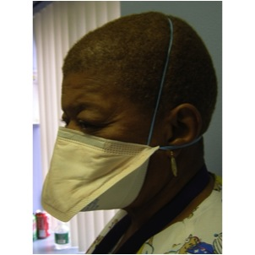
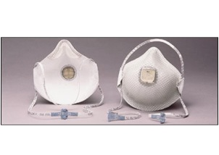
Respirators
Respirators prevent most virus particles from being inhaled. Face coverings and surgical masks do not.
An N95 respirator is the minimum level of protection to prevent inhaling coronavirus.
The employer must determine whether a respirator is needed.
Notes:
Instructor notes:
Respirators are used to prevent breathing in hazards that are in the air. Respirators protect the wearer by either filtering the air before it is inhaled by the worker, or by supplying air from a safe source. Most respirators that protect the worker by filtering the air are designed to fit tightly against the face, and thereby provide a seal between the respirator's edge and the face. When there is a proper seal, the air the worker breathes passes through the respirator’s filter, which captures contaminants. If there is not a tight seal, the air passes through the gaps between the face and the respirator and contaminants are not filtered from the air that the worker breathes.
The National Institute for Occupational Safety and Health, part of the CDC, certifies air purifying respirators, sometimes called particulate respirators, in the following categories based on the resistance to oil, which can reduce efficiency:
N95, N99, N100 - Filters at least 95%, 99%, 99.97% of airborne particles. Not resistant to oil.
R95, R99, R100 - Filters at least 95%, 99%, 99.97% of airborne particles. Somewhat resistant to oil.
P95, P99, P100 - Filters at least 95%, 99%, 99.97% of airborne particles. Strongly resistant to oil.
NIOSH approved respirators will be marked “NIOSH” and the N, R, P categories.

Slide 45

Respiratory protection standard
Respiratory programs must comply with all elements of OSHA Standard 29 CFR 1910.134
Written program
Selection according to hazard
Medically fit to wear
Fit testing
Ensure proper use of respirators
Respirator maintenance
Labeling/color coding filters
Employee training
Program evaluation
Recordkeeping
Notes:
Instructor notes:
Respirators must be used according to OSHA’s Standard 1910.134. OSHA requires that employers:
Have a written program with worksite specific procedures.
Select respirators based on the hazards in the workplace.
Provide a medical evaluation to determine the employee’s ability to wear a respirator.
Fit test respirators that require a tight seal between the worker’s face and the respirator.
Establish and implement procedures for the proper use of respirators.
Provide for cleaning, storage, and repair of respirators.
Ensure that all filters, cartridges and canisters are labeled and color coded.
Train workers at least once a year on the proper use and limitations of respirators.
Conduct an evaluation to make sure the respiratory program is being properly implemented.
Keep records on medical evaluations, fit testing and other aspects of the program.
Due to the shortage of respirators, NIOSH has issued a memo regarding extended and reuse of N95 air purifying respirators. https://www.cdc.gov/niosh/topics/hcwcontrols/recommendedguidanceextuse.html

Slide 46
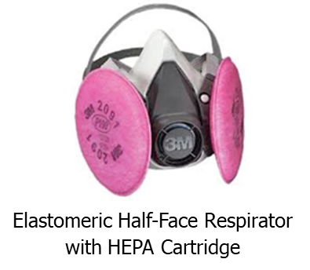
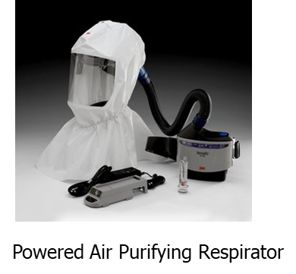
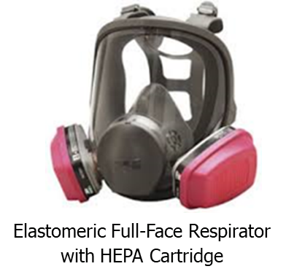
Respirators (continued)
Advantages of reusable respirators:
  Durability
  Stand up to repeated cleaning & disinfection
  Maintain fit over time
  Cost savings
Powered air-purifying respirator (PAPR)
Half or full-face elastomeric respirators
Notes:
Instructor notes:
There are many types of respirators that are designed to be reused and that provide a number of advantages over disposable respirators against airborne hazards. A half-face or full-face elastomeric air-purifying respirator provides a tighter fit. A full face elastomeric has a higher level of protection than a disposable or half face respirator.
Powered air purifying respirators can be either tight-fitting or loose-fitting depending on the design. In either case, air is drawn in by a pump and travels through a hose. The air passes through a filter before being blown across the worker’s face.
Employers must ensure that employees are using the proper filter for the hazard. P-100 or HEPA cartridges are recommended. See 29 CFR 1910.134.

Slide 47
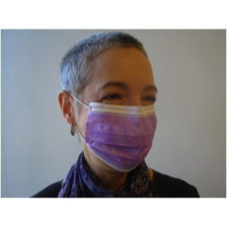
Respirators (continued)
Surgical masks are not respirators!
Surgical masks do not:
Fit tightly against the skin to form a seal
Filter tiny particles, such as viruses or bacteria that are in the air
Notes:
Instructor notes:
Surgical masks are not respirators. Surgical masks are not designed or certified to prevent the wearer from inhaling small airborne hazards, such as viruses, or virus particles. Surgical or procedure masks do not form a tight seal against the user's face. Therefore, when the wearer breathes in, much of the potentially infectious air passes through gaps between the face and the surgical mask. Second, many surgical masks are not made of a material that can filter microscopic particles. Only surgical masks that are cleared by the U.S. Food and Drug Administration and legally marketed in the United States have been tested for their ability to resist blood and body fluids can be used.
Surgical masks are used as a physical barrier to protect employees from hazards such as splashes of large droplets of blood or body fluids. Surgical masks also prevent contamination by trapping large particles of body fluids that may contain bacteria or viruses when they are expelled when the wearer coughs and sneezes.
Surgical/procedure masks are used for several different purposes, including:
Being placed on sick people to limit the spread of infectious respiratory secretions to others.
Worn by health care providers to prevent accidental contamination of patients' wounds by the organisms normally present in mucus and saliva
Worn by employees to protect themselves from splashes or sprays of blood or body fluids; they may also have the effect of keeping contaminated fingers/hands away from the mouth and nose.
Bandannas, neck gators, etc. are not respirators - their use DOES NOT afford any protection to inhalation of airborne droplets containing the virus. However using one of these items may reduce the frequency that people touch their face.

Slide 48

What about CDC’s recommendation to wear cloth face coverings in public settings?
They are not PPE
There is no seal to the face.
Factors like moisture on the cloth may concentrate droplets.
Face coverings will capture or slow some droplets when a person speaks, coughs or sneezes. This reduces risk of exposure but does not eliminate it.
CDC recommends wearing a face covering in settings where social distancing is difficult to maintain.
Notes:
Instructor notes:
https://www.cdc.gov/coronavirus/2019-ncov/prevent-getting-sick/cloth-face-cover.html
On May 16, 2020, CDC revised the guidance on the use of cloth face coverings. Recent studies show the virus can spread between people interacting in close proximity—for example, speaking, coughing, or sneezing—even if those people are not exhibiting symptoms. In light of this new evidence, CDC recommends wearing cloth face coverings in public settings where other social distancing measures are difficult to maintain (e.g., grocery stores and pharmacies) especially in areas of significant community-based transmission.
Other references:
https://www.sciencedirect.com/science/article/pii/S2468042720300117?via%3Dihub
https://science.sciencemag.org/content/early/2020/06/08/science.abc6197

Slide 49

Dr. Jerome Adams, Surgeon General
https://youtu.be/tPx1yqvJgf4

Slide 50
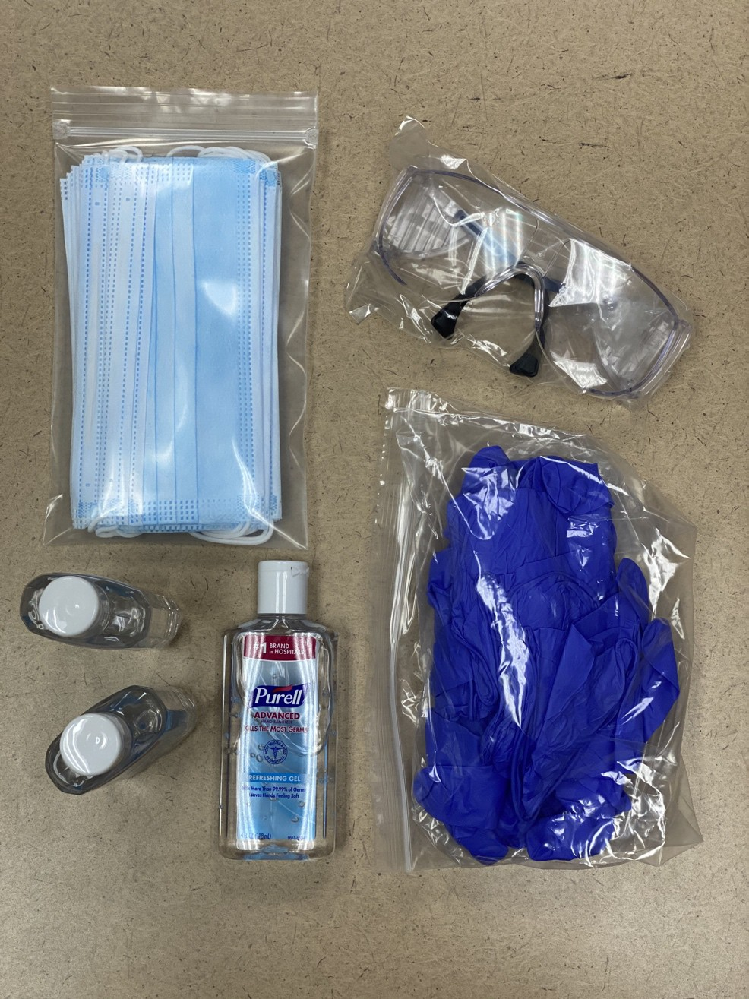
COVID-19 care kits
Surgical mask
Safety glasses
ASU provides these to essential workers
Gloves
Hand sanitizer

Slide 51

Donning and doffing PPE
Source: National Institute of Allergies and Infectious Diseases
Notes:
Examples of videos:
CDC donning and doffing PPE healthcare workers
https://www.youtube.com/watch?v=of73FN086E8&feature=youtu.be
https://www.youtube.com/watch?v=of73FN086E8&feature=youtu.be

Slide 52
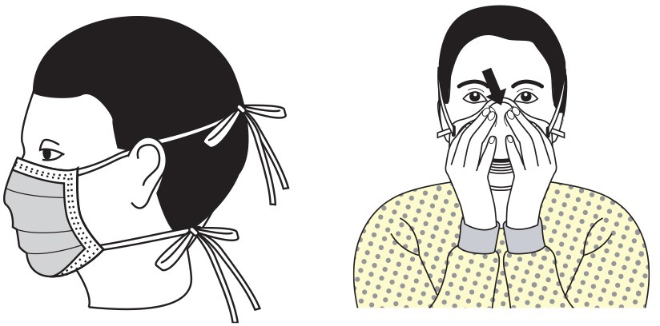
Donning and doffing of PPE
Donning and doffing is the practice of putting on and removing personal protective equipment.
Donning refers to putting on personal protective equipment.
Doffing refers to removing personal protective equipment.
Image: CDC

Slide 53
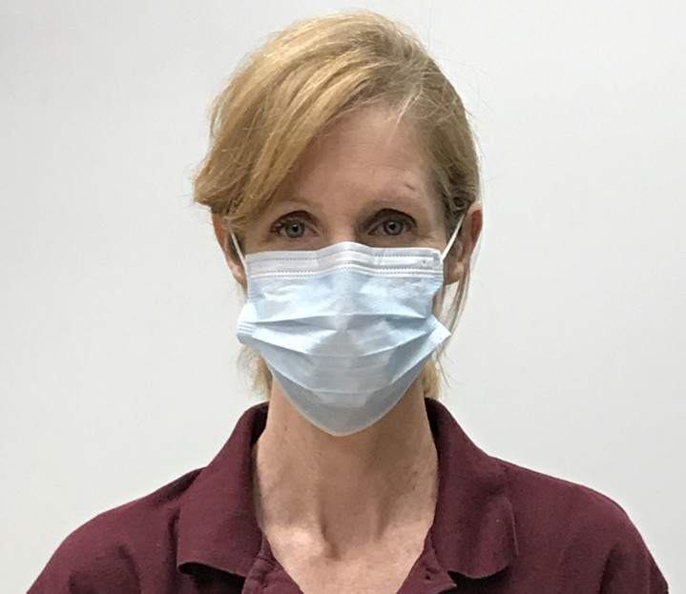
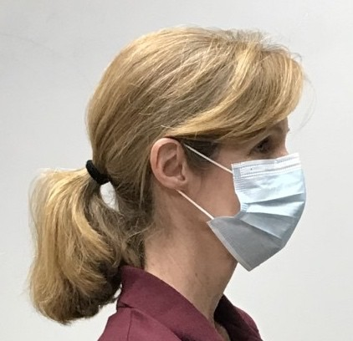
Donning a surgical mask
Wash hands with soap and water or apply hand sanitizer before donning a mask.
Place mask on face with ear loops over ears.
The mask should cover your nose and mouth with no gaps between the mask and your face.
Wash hands with soap and water or apply hand sanitizer.
Avoid touching the mask while wearing it.
Image: ASU

Slide 54
Doffing a surgical mask
Wash hands with soap and water or apply hand sanitizer.
Use the ear loops to remove the mask avoiding touching the front of the mask or your face.
If the mask is in good condition and not soiled, you may reuse it.
Carefully place the mask into a clean Ziploc bag, labeled with the user’s name. Avoid compressing the mask. Do not seal the bag.
Wash hands with soap and water or apply hand sanitizer.
Note: If the mask was worn during an encounter with another person who displayed obvious signs of illness, discard of the mask in the trash.

Slide 55
Reusing a surgical mask
If using a surgical mask and following social distancing practices, the likelihood of the mask being contaminated is very low.
Wash hands with soap and water or apply hand sanitizer.
Remove mask by holding the ear loops.
After removing facemask, visually inspect for contamination, distortion in shape or form. Discard in trash if soiled, torn, or saturated.
Carefully store in an unsealed bag labeled with your name on it.
Wash hands with soap and water or apply hand sanitizer.

Slide 56
Demonstration of surgical mask and cloth face cover donning and doffing procedures

Slide 57
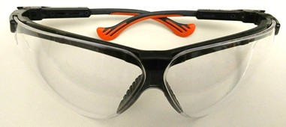
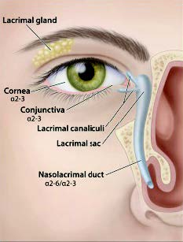
Procedures for donning safety glasses
Wash hands with soap and water or apply hand sanitizer before donning safety glasses.
Remove the safety glasses from package or storage container.
Photo: ASU
3. Place safety glasses directly on your face. Do not set the safety glasses on surfaces.
Image: NIEHS

Slide 58
Procedures for doffing safety glasses
Wash hands with soap and water or apply hand sanitizer. If wearing gloves, remove gloves before removing safety glasses.
Remove safety glasses. Avoid touching your eyes and face.
Clean safety glasses with soap and water solution. Let dry before storing them.
Place safety glasses in clean plastic container or Ziploc bag for reuse.

Slide 59
Demonstration of safety glasses donning and doffing procedures

Slide 60
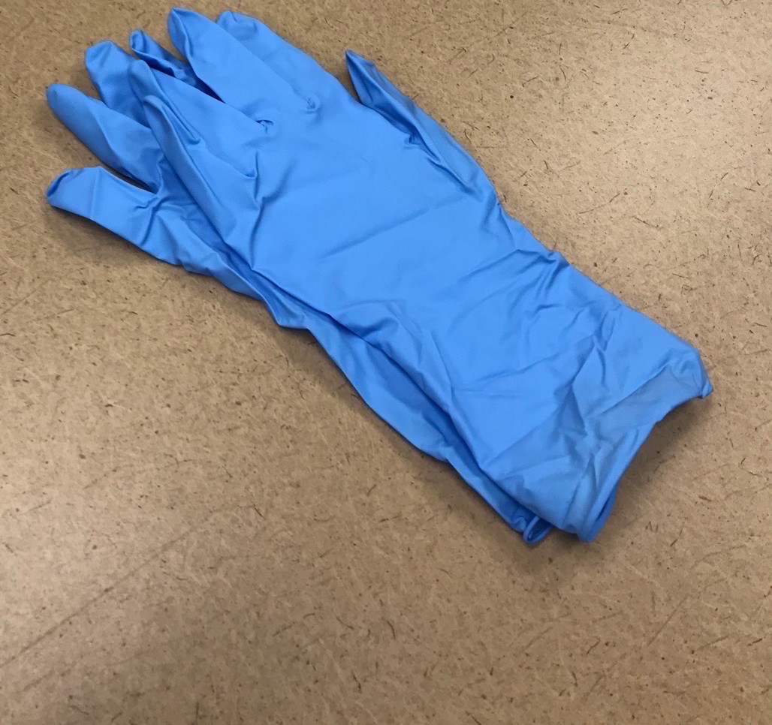
Procedures for donning gloves
Wash hands with soap and water or apply hand sanitizer before donning gloves.
Select properly sized gloves.
Don one glove per hand.
Inspect gloves for any tears or holes and replace gloves if any defects are detected.
Image: ASU

Slide 61
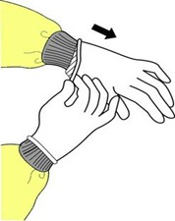
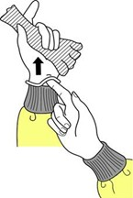
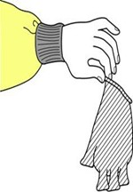
Procedures for doffing gloves
Grasp the outside edge near your wrist.
Peel away from your hand, turning the glove inside- out.
Hold in opposite gloved hand.
Slide ungloved finger under the wrist of the remaining glove.
Peel off from inside, creating a bag for both gloves.
Discard gloves in the garbage.
Image: CDC

Slide 62
Demonstration of gloves donning and doffing procedures

Slide 63
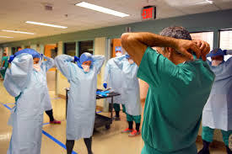
Training and drills
Must be hands-on and frequent
Should not be primarily computer based or lecture
Must include an opportunity to drill the actual process of donning and doffing PPE and respirators
Should include a trained observer
Cover site specific decontamination procedures.
Notes:
Instructor notes:
Photo: courtesy of defense.gov
For awareness level training, distance learning is going to be more prevalent in this national emergency due to the inability for gatherings of people in classrooms and travel of instructors. However, for donning and doffing of PPE and respirators, hands on training is necessary. Many studies have documented that improper donning and doffing have caused workers to be contaminated.
Reference: JAMA Intern Med. 2015;175(12):1904-1910. doi:10.1001/jamainternmed.2015.4535
Published online October 12, 2015.
CONCLUSIONS AND RELEVANCE: Contamination of the skin and clothing of health care personnel occurs frequently during removal of contaminated gloves or gowns. Educational interventions that include practice with immediate visual feedback on skin and clothing contamination can significantly reduce the risk of contamination during removal of PPE.

Slide 64

Interim Guidance for Employers with Workers at High Risk
Send a worker with COVID-19 symptoms home
Assist with safe transport of the ill worker if assistance is needed (no mass transit usage)
Notify local health officials, staff and customers of a possible case; maintain confidentiality
Close off areas used by the sick person until after cleaning and disinfection
Inform close contacts of a diagnosed COVID-19 case to stay home and self –monitor
Follow CDC guidance for isolation and quarantine (see next slide)
Employers must report workplace acquired illness to OSHA or ADOSH when the person is admitted to a hospital; and record the incident to the OSHA 300 log.
Notes:
Instructor notes:
See: https://www.cdc.gov/coronavirus/2019-ncov/downloads/php/CDC-Activities-Initiatives-for-COVID-19-Response.pdf#page=49
https://www.cdc.gov/coronavirus/2019-ncov/community/critical-workers/implementing-safety-practices.html
If an employee receives medical attention and is not admitted to a hospital, the incident does not require reporting, but it requires recording into the OSHA 300 log.
Many public and occupational health experts and organizations are concerned that the CDC guidelines, issued on April 8, 2020, will lead to further spread of SARS CoV-2 in essential worksites. With significant outbreaks in nursing homes, food processing plants, and other locations it is clear that in worksites that are congested with people, SARS CoV-2 can spread rapidly. Further, people can be contagious and have no symptoms. It is feasible that the virus can be transmitted by breathing. For these reasons CDC’s more protective home isolation guidelines are a stronger choice for workers and employers in addressing exposures.
See the next slide for more protective approach to exposures at work.

Slide 65
CDC Guidance for workers exposed to suspect CV-19
Stay home until 14 days after last exposure and maintain social distance from household members
Self-monitor
If symptoms develop:
  Isolate yourself
  If no test you may return to work after at least 10 days have passed since your symptoms first appeared and you have had no fever for at least 72 hours without meds and other symptoms improved
  If tested, you had two negative tests in a row, at least 24 hours apart and you no longer have a fever and you have improved symptoms
Notes:
Instructor Notes
https://www.cdc.gov/coronavirus/2019-ncov/prevent-getting-sick/when-its-safe.html
Arizona Department of Health Services guidance:
https://azdhs.gov/documents/preparedness/epidemiology-disease-control/infectious-disease-epidemiology/novel-coronavirus/public-resources/release-from-isolation.pdf?utm_medium=email&utm_source=govdelivery
Consult your doctor.
Follow local health department requirements which may be more stringent.
Employers may apply stricter criteria.
Some people may continue to shed virus after they recover, especially those with conditions that weaken their immune system.

Slide 66
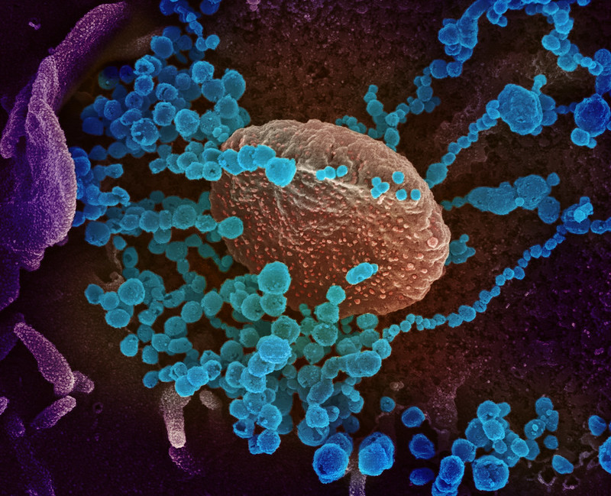
What if a worker tests positive and does not have symptoms?
Close off areas used by the person who tested positive.
Send the worker home to start a 14-day self-quarantine, provide information on self-monitoring, and to watch for symptoms that warrant going to the emergency department.
Follow CDC and local guidelines for cleaning and disinfecting.
https://www.cdc.gov/coronavirus/2019-ncov/community/organizations/cleaning-disinfection.html
https://www.cdc.gov/coronavirus/2019-ncov/hcp/disposition-in-home-patients.html
Photo: National Institute of Allergies and Infectious Diseases
Notes:
Instructor notes:
Employers should develop policies for decisive action when a worker tests positive for COVID-19. The CDC guidelines are at the links at the bottom of the slide and address the issues framed on the slide. Additionally, the employer should investigate if the positive test was a result of a work exposure or an inadequate prevention program. Workers who are infected at work may be entitled to workers’ compensation, state, or employer-based benefits.
The CDC language on discontinuing home isolation is below. The 14-day home isolation recommendation on the slide goes beyond the minimum recommendation in the CDC guidelines. The CDC recommendation is based on symptoms or testing and doesn’t consider the potential of asymptomatic people transmitting the virus. https://www.cdc.gov/coronavirus/2019-ncov/hcp/disposition-in-home-patients.html
For Persons with COVID-19 Under Isolation:
The decision to discontinue isolation* should be made in the context of local circumstances. Options now include both 1) a time-based strategy, and 2) test-based strategy.
1). Time-based strategy
Persons with laboratory-confirmed COVID-19 who have not had any symptoms and were directed to care for themselves at home may discontinue isolation under the following conditions:
At least 10 days have passed since the date of their first positive COVID-19 diagnostic test assuming they have not subsequently developed symptoms since their positive test. If they develop symptoms, then the symptom-based or test-based strategy should be used. Note, because symptoms cannot be used to gauge where these individuals are in the course of their illness, it is possible that the duration of viral shedding could be longer or shorter than 10 days after their first positive test.
2). Test-based strategy
Persons with laboratory-confirmed COVID-19 who have not had any symptoms and were directed to care for themselves at home may discontinue isolation under the following conditions:
Negative results of an FDA Emergency Use Authorized COVID-19 molecular assay for detection of SARS-CoV-2 RNA from at least two consecutive respiratory specimens collected ≥24 hours apart (total of two negative specimens)*. See Interim Guidelines for Collecting, Handling, and Testing Clinical Specimens from Persons for Coronavirus Disease 2019 (COVID-19). Note, because of the absence of symptoms, it is not possible to gauge where these individuals are in the course of their illness. There have been reports of prolonged detection of RNA without direct correlation to viral culture.
The CDC guidelines “Criteria for Return to Work for Healthcare Personnel with Confirmed or Suspected COVID-19 (Interim Guidance)”: https://www.cdc.gov/coronavirus/2019-ncov/hcp/return-to-work.html
Arizona Department of Health Services guidance:
Stay home away from others or under isolation precautions until 10 days have passed since specimen collection of the first positive COVID-19 PCR/antigen test while asymptomatic. See the full guidance at:
https://azdhs.gov/documents/preparedness/epidemiology-disease-control/infectious-disease-epidemiology/novel-coronavirus/public-resources/release-from-isolation.pdf?utm_medium=email&utm_source=govdelivery

Slide 67
Critical Infrastructure Workers Who May Have Had Exposure to a Person with Suspected or Confirmed CV-19
If asymptomatic:
  The worker may continue to work
  Pre-screen for symptoms; self-monitor; wear a mask; social distance; clean and disinfect surfaces
If symptomatic:
  Send the worker home to begin isolation
  Identify and inform all persons who had close contact during the 48 hours before symptoms
  If COVID-19 was confirmed, may return to work after meeting the symptom-based or test-based strategy given by CDC; and
  Follow state and local health department guidance
Notes:
This is from CDC Guidance at: https://www.cdc.gov/coronavirus/2019-ncov/community/critical-workers/implementing-safety-practices.html and https://www.cdc.gov/coronavirus/2019-ncov/hcp/disposition-in-home-patients.html . The return to work guidance does not apply to persons working in healthcare settings.
Limited information is available to characterize COVID-19 disease transmission. The CDC may update guidance based on new information. Check the CDC web pages frequently.
Some persons should isolate for longer periods of time such as those who work in close contact with vulnerable persons or if the recovering person is immunocompromised.
Employers and local public health authorities may apply more stringent criteria.

Slide 68

Alternative: apply CDC’s general home isolation guidelines to worker exposures
14 days of home-isolation for exposed workers.
Employer to isolate surfaces and equipment until thorough cleaning and disinfection are performed.
Work with public health department to trace contacts.
Evaluate effectiveness of preventive measures.
Notes:
Instructor notes:
CDC recommends 14 days of home isolation for the general public if they have contact with a person with COVID-19. See: https://www.cdc.gov/coronavirus/2019-ncov/prevent-getting-sick/social-distancing.html It makes sense to apply the 14-day home isolation to essential workers who are exposed.
Other steps that should be taken include closing off areas visited by the person who is a probable or confirmed case of COVID-19. Open outside doors and windows and use ventilation fans to increase air circulation in the area. Wait a minimum of 24 hours, or as long as practical, before beginning cleaning and disinfection. Cleaning staff should clean and disinfect all areas and equipment. Additional steps are detailed in the guideline below.
The Secretary of Public Health in Pennsylvania has issued a strong order detailing requirements for businesses:
https://www.governor.pa.gov/wp-content/uploads/2020/04/20200415-SOH-worker-safety-order.pdf

Slide 69
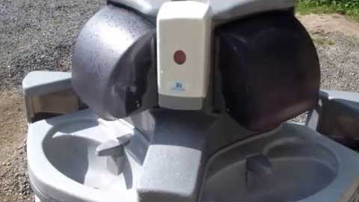
Construction Worker Guidance from CDC
Maintain at least 6 feet distance at all times from others
Wear cloth face coverings
Limit tool sharing; disinfect in between shared uses
Employers must provide handwashing/hand hygiene for workers
Employers must implement specific policies to protect those at higher risk of severe illness
Train employees about the COVID-19 procedures (29 CFR 1926 Subpart E)
Follow CDC steps for exposures to COVID-19 and symptomatic workers
Consult the local health department if a worker develops COVID-19 symptoms
Report workplace acquired illness as required by OSHA/ADOSH
Notes:
See: https://www.cdc.gov/coronavirus/2019-ncov/community/organizations/construction-workers.html
Thank you to Potty Pros for sharing the video of a portable handwashing station. http://www.pottypros.com/
There are more than 20 health and safety guidance documents for specific occupations now posted on the CDC web page: https://www.cdc.gov/coronavirus/2019-ncov/community/worker-safety-support/index.html
OSHA has many excellent industry-specific guidance documents: https://www.osha.gov/SLTC/covid-19/additional_resources.html
Professional associations, trade associations and other non-governmental organizations have many excellent work setting specific guidance documents. An example is the American Industrial Hygiene Association at: https://www.backtoworksafely.org/

Slide 70

Tribal Community Resources
Some tribal communities may be at higher risk due to disparities in access to primary care, food insecurity, multigenerational households, access to running water, access to electricity and more.
Guidance on COVID-19 prevention at workplaces and home published by federal, state and local health agencies is applicable. OSHA standards apply on all tribal lands and are enforced by OSHA not ADOSH in Arizona.
Community level pandemic information may be accessed on the tribal community’s website.
Additional resources for tribal communities published by CDC may be accessed at: https://www.cdc.gov/coronavirus/2019-ncov/community/tribal/index.html
Video:
Notes:
The Navajo Nation has been especially impacted by the COVID-19 pandemic.
Each tribal community in Arizona is sovereign and may choose to apply more stringent epidemic control measures.
For example, the Opening up America guidance may be applied regionally, including at the tribal community level.

Slide 71
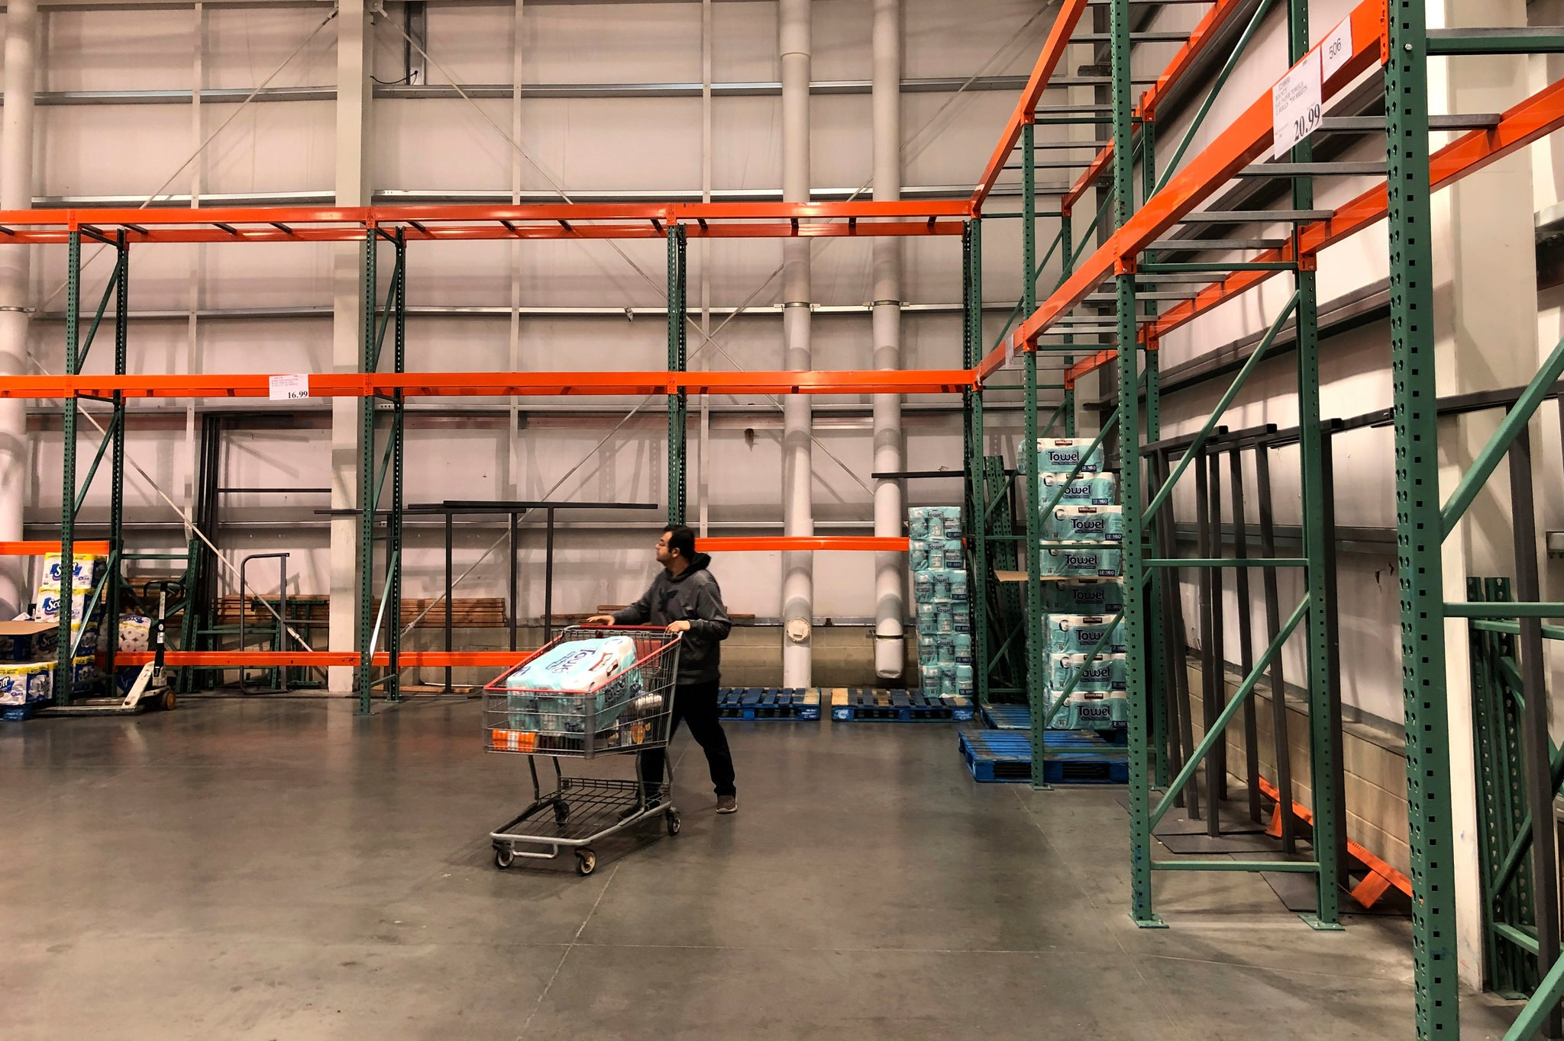
Continuity of Operations (COOP)
All businesses and agencies should have a strategy to overcome potential disruptions to operations for:
  maintaining critical utilities and infrastructure;
  rostering personnel with authority and knowledge of functions;
  policies that enable employees to work remotely;
  communications with employees and customers, including during disruptions to usual services;
  stockpiling supplies or developing multiple suppliers in the event of a supply chain disruption.
Notes:
Instructor notes:
FEMA Brochure: “What is Continuity of Operations?”
https://www.fema.gov/pdf/about/org/ncp/coop_brochure.pdf
Disaster Management checklist: https://www.paho.org/disasters/index.php?option=com_docman&view=download&category_slug=tools&alias=543-pandinflu-leadershipduring-tool-16&Itemid=1179&lang=en
Cross training is another important step in COOP.
Photo by Al Brown

Slide 72
Notes:
See: https://www.whitehouse.gov/openingamerica/
Three phases of reopening based on public health gating criteria.
The first phase is applicable in States and regions where influenza-like illnesses and COVID-19 have been declining for 14 days and the healthcare system has adequate capacity and testing capability. A limited reopening may proceed.
The second phase is applicable in States and regions with no evidence of a rebound an that satisfy the gating criteria a second time. The reopening guidelines expand the types of places that may reopen and include less restrictive control measures.
The third phase is applicable in States and regions with no evidence of a rebound and satisfy the gating criteria a third time. All types of businesses may open but with limited physical distancing and diligence to hygiene and sanitation.

Slide 73
Notes:
Instructor notes:
This is a decision tool published by the CDC at: https://www.cdc.gov/coronavirus/2019-ncov/community/organizations/workplace-decision-tool.html
Check with state and local health officials to determine the most appropriate actions while adjusting to meet the unique needs and circumstances of the local community.
Compliance with OSHA standards must be considered by the employer. Each workplace is unique. The reopening plan must be site-specific.
Going out, updated June 12:
https://www.cdc.gov/coronavirus/2019-ncov/daily-life-coping/activities.html

Slide 74
Applicable OSHA Standards
General Duty Clause: OSHA Section 5(a)(1)
29 CFR § 1904 Recording and Reporting Occupational Injuries and Illnesses
29 CFR 1910 Subpart I Personal Protective Equipment
All PPE
Eye and Face Protection
Respiratory Protection
Hand protection
29 CFR §1910.141 Sanitation
29 CFR § 1910.145 Accident Prevention Signs and Tags
29 CFR § 1020 Access to Employee Exposure and Medical Records
29 CFR § 1910.1200 Hazard Communication
29 CFR § 1910.1030 Bloodborne Pathogens; only for specific job tasks
Notes:
Instructor notes:
CDC: https://www.cdc.gov/coronavirus/2019-ncov/community/reopen-guidance.html
Environmental Health comprehensive list of guidance:
https://www.cdc.gov/coronavirus/2019-ncov/php/eh-practitioners.html
ADHS workplaces:
https://www.azdhs.gov/preparedness/epidemiology-disease-control/infectious-disease-epidemiology/index.php#novel-coronavirus-community

Slide 75

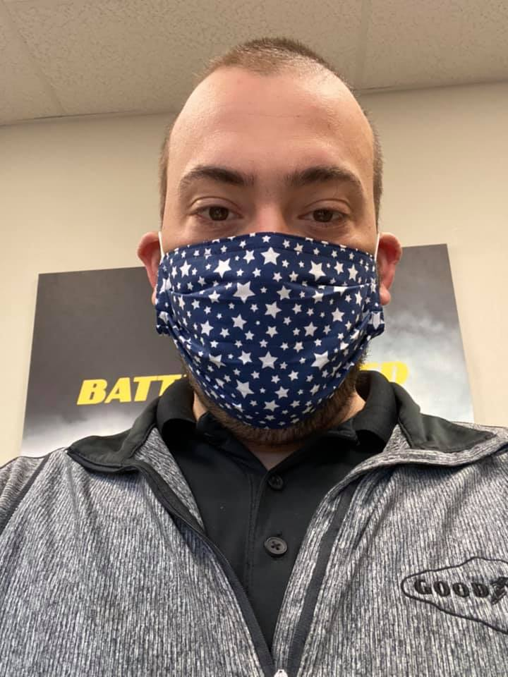
Are these safeguards adequate?
Notes:
Instructor notes:
Ask participants to name the hazards and safeguards in the photos. Then ask if the safeguards are adequate. If not, ask what would they suggest?
What is the hazard: for the nurse the hazard includes diagnosing or treating a contagious patient. For the store manager the hazard includes coming within 6 feet of a contagious customer or coworker or touching a contaminated surface or item.
The photo on the left shows a nurse working at an outpatient clinic that has a high volume of patients with respiratory complaints. The photo on the right shows a Goodyear Tire store manager wearing a cloth mask.
The RN in the photo on the left is wearing a procedure mask, not an N95 respirator. The store manager is not protected by potentially contagious customers by wearing a cloth mask. ​

Slide 76


Are these safeguards adequate?
Notes:
Instructor notes:
Ask participants to name the hazards and safeguards in the photos. Then ask if the safeguards are adequate. If not, ask what would they suggest?
What is the hazard: coming within 6 feet of a contagious customer or coworker or touching a contaminated surface or item.
The signs in the photo let customers know that they are limited to two of each for certain high demand items. Previous features that allowed for high touch self-service have been suspended and use of customers own bags is no longer permitted. Additional signage and markings require 6 feet, social distancing.
Other possibilities: 1) Limit the number of customers allowed in the store. 2) Allow only one-way traffic in the store aisles. 3) Only permit pick up service so that no one enters the store. 4) Provide a minimum N95 fit tested respirator to cashiers and other employees that cannot maintain 6 feet of social distancing.
The floor markings in the photo on the left are used to maintain separation between customers. Will customers comply? If there is no limit on the number of customers, how effective will this approach be? How will the store maintain social distancing when workers are stocking shelves?

Slide 77
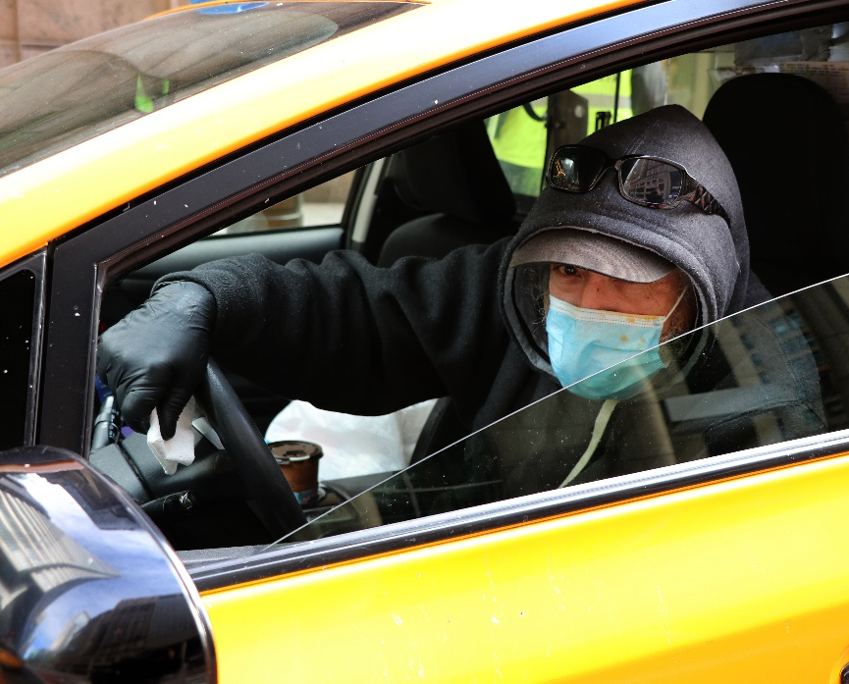
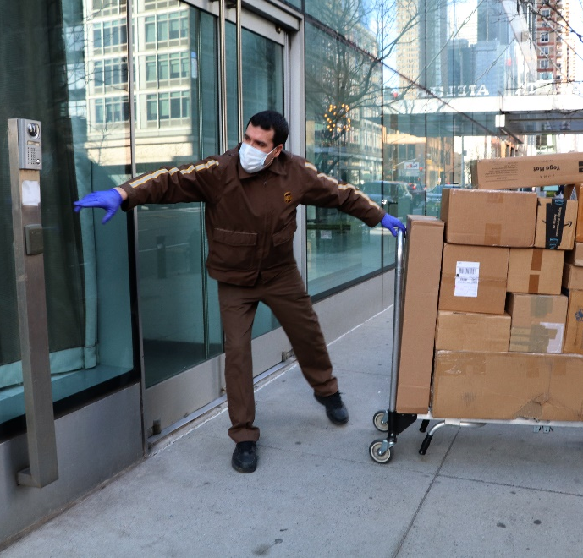
Are these safeguards adequate?
Notes:
Instructor notes:
Ask participants to name the hazards and safeguards in the photos. Then ask if the safeguards are adequate. If not, ask what would they suggest?
What is the hazard: For the cab driver it would include coming within 6 feet of a contagious passenger or touching a contaminated surface or item.
On the right, the hazard is coming within 6 feet of a contagious customer or touching a contaminated surface or item.
The photo on the left by Karen Berman shows a city cab driver wearing a surgical mask and gloves. The photo on the right shows a postal worker making a delivery, donning gloves and a surgical mask.

Slide 78
In conclusion
Thank you for attending today’s program. We hope you benefit from an increased awareness of the methods that can be used to protect yourself and your co-workers from the COVID-19 virus. Please share these materials with co-workers, supervisors, and organizational leaders.
Notes:
Instructor notes:

Slide 79
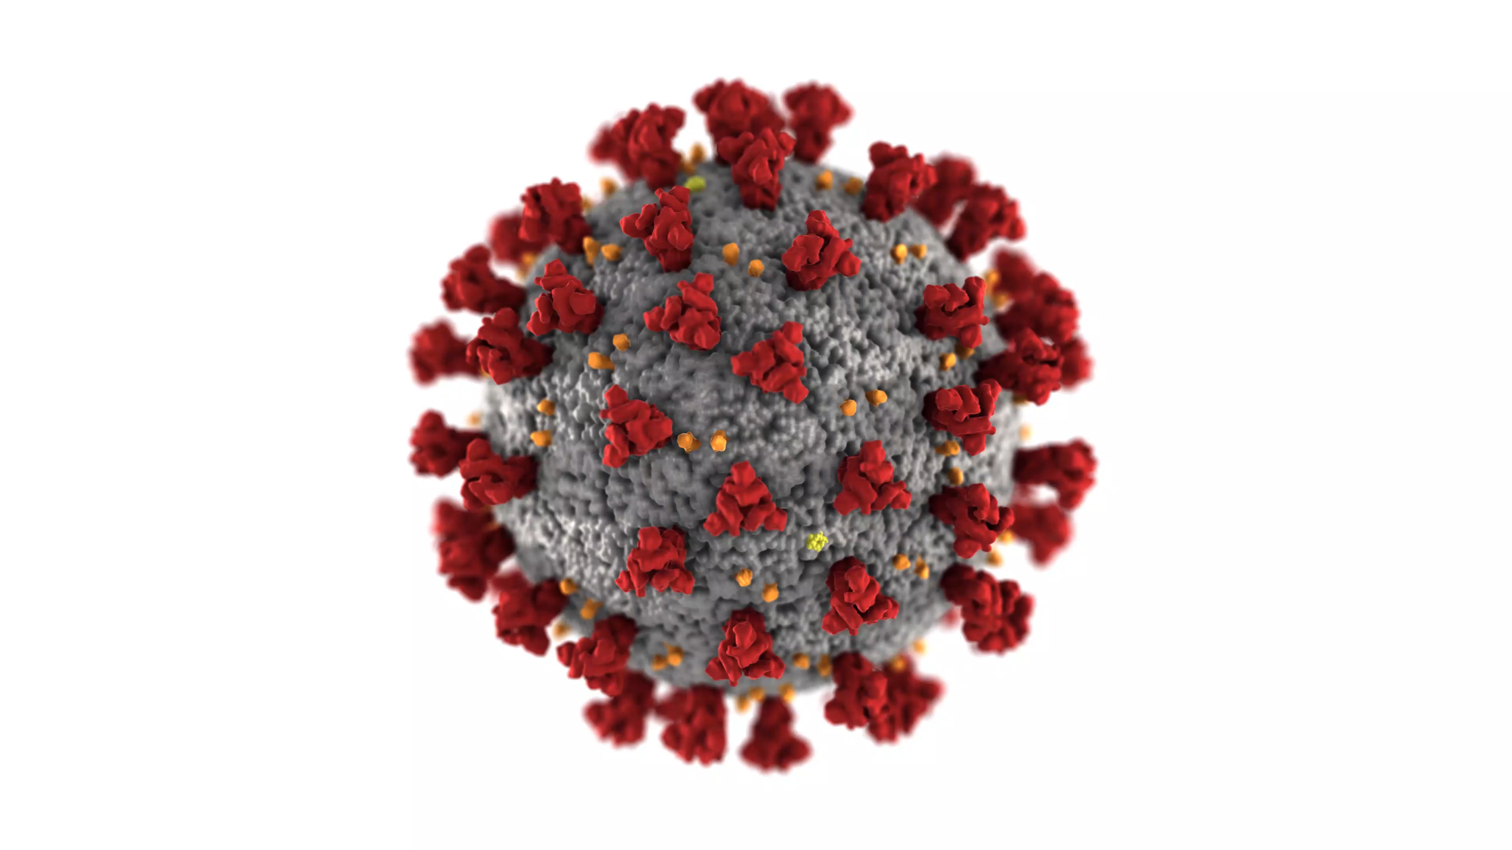
For more information
Centers for Disease Control and Prevention (CDC)
http://www.cdc.gov
Occupational Safety and Health Administration (OSHA)
http://www.osha.gov
World Health Organization (WHO)
http://www.who.int/en/
National Institute for Occupational Safety and Health (NIOSH)
http://www.cdc.gov/NIOSH/
NIEHS Worker Training Program
https://tools.niehs.nih.gov/wetp/index.cfm?id=2554
Return to work checklist
file:///E:/Grants/COVID-19/NIEHS%20files/Return%20to%20work%20workplace_covid_19_checklist_051120_508.pdf
Notes:
Instructor notes:

Slide 80
For more information
U.S. Food and Drug Administration
https://www.fda.gov/food/food-safety-during-emergencies/best-practices-retail-food-stores-restaurants-and-food-pick-updelivery-services-during-covid-19
Arizona Department of Health Services
https://www.azdhs.gov/preparedness/epidemiology-disease-control/infectious-disease-epidemiology/index.php#novel-coronavirus-home
Arizona Division of Occupational Safety and Health
https://www.azica.gov/divisions/adosh
Arizona Chapter Association of General Contractors
https://www.azagc.org/
Arizona Public Health Association
http://www.azpha.org/
Inter Tribal Council of Arizona
https://itcaonline.com/
Arizona State University Environmental Health and Safety
https://cfo.asu.edu/biosafety-program

Slide 81

Thank you!

