Slide 1

COVID-19 General Public Health Awareness Training
For all people; Summer 2020
Photo: CDC
The Polytechnic School Environmental & Resource Management Program

Slide 2
Disclaimer and acknowledgements
The information provided in this training is based on current information regarding best practices obtained from guidance and publications issued by the U.S. Centers for Disease Control and Prevention, U.S. Occupational Safety and Health Administration, National Institutes of Environmental Health Sciences (NIEHS), Arizona Department of Health Services (ADHS) as well as other federal, state and local public health officials, as of June 15, 2020.
This training is funded by the NIEHS Worker Training Program, through the UCLA Labor Occupational Safety and Health Program. The ASU Environmental & Resource Management Program (ERM) developed this training. ASU thanks the ADHS, Arizona Division of Occupational Safety and Health, Arizona Association of General Contractors, Arizona Public Health Association, Inter Tribal Council of Arizona and the Associated Minority Contractors of Arizona for review and comment on training materials. Special thanks to the ASU Environmental Health and Safety Program for permission to share slides.

Slide 3
This training...
provides general information about the COVID-19 pandemic in the United States. The training is intended for the general public as a supplement to the information that has been published by federal, state and local public health and food safety organizations.

Slide 4
Goal:
Increase health and safety awareness for the general public.
Objectives:
Explain basic facts about COVID-19.
Assess the risk of daily life exposure to COVID-19.
Identify methods to prevent and respond to COVID-19 exposure.
Understand applicable Opening Up America Again guidelines

Slide 5
Contents
Module 1 COVID-19 Basics
Module 2 Assessing the Potential for Exposure to COVID-19 in daily life activities
Module 3 Methods to Prevent COVID-19 in the household
Responding to COVID-19 infection in the household

Slide 6
Module 1: COVID-19 Basics
Notes:
Instructor notes:
Because SARS-CoV-2 is a new virus, information is changing on almost a daily basis. It is very important to check authoritative sources of information to make sure the training material is current. This includes primary sources like the CDC, OSHA, NAID, and peer reviewed journals such as JAMA, NEJM, etc.

Slide 7
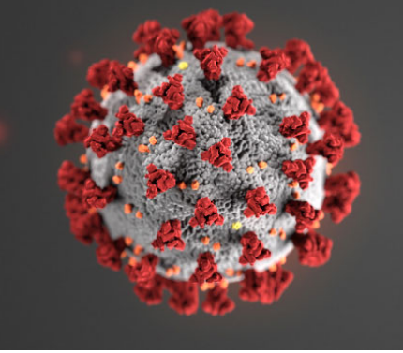
What is SARS-CoV-2?
SARS-CoV-2 is the virus that causes coronavirus disease 2019 (COVID-19)
SARS = severe acute respiratory distress syndrome
Spreads easily person-to-person
Little if any pre-exposure immunity in humans
Detailed information: https://www.cdc.gov/coronavirus/2019-ncov/index.html
Source: NIEHS
Notes:
Instructor notes:
The virus has been named “SARS-CoV-2” and the disease it causes has been named “coronavirus disease 2019” (abbreviated “COVID-19”). Throughout this training we refer to the virus as SARS CoV-2 and the disease as COVID-19.
Coronaviruses are a large family of viruses that are common in people and many different species of animals, including camels, cattle, cats, and bats. Rarely, animal coronaviruses can infect people and then spread between people such as with MERS-CoV, SARS-CoV, and now with this new virus (named SARS-CoV-2).
The SARS-CoV-2 virus is a betacoronavirus, like MERS-CoV and SARS-CoV. All three of these viruses have their origins in bats. The sequences from U.S. patients are similar to the one that China initially posted, suggesting a likely single, recent emergence of this virus from an animal reservoir. (https://www.cdc.gov/coronavirus/2019-nCoV/summary.html)
The SARS-CoV-2 virus is a novel strain, meaning that it is new. As a result, humans have not developed immunity to COVID-19, and therefore can be infected. Acquired immunity is when humans have been exposed or vaccinated previously to an infectious agent. An example is when people have measles in childhood or are vaccinated, they develop antibodies and a certain level of protection.
Early on, many of the patients at the epicenter of the outbreak in Wuhan, Hubei Province, China had some link to a large seafood and live animal market, suggesting animal-to-person spread. Later, a growing number of patients reportedly did not have exposure to animal markets, indicating person-to-person spread. Person-to-person spread was subsequently reported outside Hubei and in countries outside China, including in the United States. Some international destinations now have apparent community spread with the virus that causes COVID-19, as do some parts of the United States. Community spread means some people have been infected and it is not known how or where they became exposed.

Slide 8
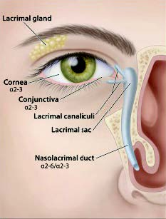
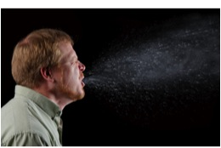
Transmission
COVID-19 is spread from person to person mainly through coughing, sneezing, and possibly talking and breathing.
Droplet - respiratory secretions from coughing or sneezing landing on mucosal surfaces (nose, mouth, and eyes)
Aerosol - a solid particle or liquid droplet suspended in air
Contact -Touching something with SARS-2 virus on it and then touching mouth, nose or eyes
Other possible routes: Through fecal matter
Source: NIEHS
Notes:
Instructor notes:
Spread of SARS-CoV-2, the virus that causes COVID-19, is thought to occur in the same way that seasonal flu spreads. Flu viruses are spread mainly from person to person through coughing or sneezing by people with influenza. We will not fully know how it is transmitted until later when scientists have had time to evaluate it.
Droplet transmission occurs when respiratory secretions from coughing or sneezing land on mucosal surfaces (nose, mouth, and eyes).
Contact transmission is touching something with COVID-19 virus on it and then touching your mouth, nose or eyes.
Aerosol transmission means breathing in infectious COVID-19 particles.
Keep in mind that the virus particles are not visible to the naked eye. The most harmful particles are submicron, shorter than one millionth of a meter.
Images from NIEHS

Slide 9
Transmission
Droplets deposit on surfaces within a few feet, contaminating the surfaces.
Droplets can contact the eyes, nose and mouth of an uninfected person who is within six feet of the infected person.
Aerosols containing the virus can stay suspended in air for hours and travel more than 20 feet.
Some aerosols are less than 2.5 microns and can be inhaled deeply into the lungs
Notes:
See: Reducing transmission of SARS-CoV-2; Prather, K., Wang C., Schooley R., 27 May 2020, Science
https://science.sciencemag.org/content/early/2020/06/02/science.abc6197.1

Slide 10

Incubation period
The incubation period is the time between exposure to a virus and the onset of symptoms.
With COVID-19, symptoms may show 2-14 days after exposure.
CDC indicates that people are most contagious when they are the most symptomatic.
But several studies show people are contagious before developing symptoms. The virus can be spread by people who don’t know they are infected.
Photo: National Institute of Allergies and Infectious Diseases
Source: NIEHS
Notes:
Instructor notes:
Most estimates of the incubation period for COVID-19 range from 1-14 days, most commonly around five days. The “incubation period” means the time between catching the virus and beginning to have symptoms of the disease.
This can be longer in some people, especially children and people with weakened immune systems and in people infected with the new COVID-19 virus.
A Johns Hopkins study estimated the median incubation period at 5.1 days ((95% confidence interval [CI], 4.5 to 5.8 days). They found that 97.5% of patients who have symptoms do so within 11.5 days of infection (CI, 8.2 to 15.6 days). https://annals.org/aim/fullarticle/2762808/incubation-period-coronavirus-disease-2019-covid-19-from-publicly-reported
Can someone spread the virus without being sick?
People are thought to be most contagious when they are most symptomatic (the sickest).
Some spread might be possible before people show symptoms; there have been reports of this occurring with this new coronavirus, but this is not thought to be the main way the virus spreads.
CDC: https://www.cdc.gov/coronavirus/2019-ncov/about/transmission.html
Article in medRxiv :
COVID-19 can be spread before it causes symptoms, when it produces symptoms like those of the common cold, and as many as 12 days after recovery, according to a virologic analysis of nine infected patients published on the preprint server medRxiv. https://www.medrxiv.org/content/10.1101/2020.03.07.20032052v1
In a study published in Nature Medicine, the researchers observed the highest viral load in throat swabs at the time of symptom onset, and
inferred that infectiousness peaked on or before symptom onset.
Xi He, Eric H. Y. Lau, et al, Temporal dynamics in viral shedding and transmissibility of COVID-19, Nature Medicine, Brief Communication
https://doi.org/10.1038/s41591-020-0869-5
Led by researchers in Germany, the virologic study, which has not yet been peer-reviewed, found that the novel coronavirus quickly begins producing high viral loads, sheds efficiently, and grows well in the upper respiratory tract (nose, mouth, nasal cavity, and throat).
https://www.medrxiv.org/content/10.1101/2020.03.05.20030502v1.full.pdf
http://www.cidrap.umn.edu/news-perspective/2020/03/study-highlights-ease-spread-covid-19-viruses
Article in JAMA: Air, Surface Environmental, and Personal Protective Equipment Contamination by Severe Acute Respiratory Syndrome Coronavirus 2 (SARS-CoV-2) From a Symptomatic Patient
Citation: Ong SWX, Tan YK, Chia PY, et al. Air, Surface Environmental, and Personal Protective Equipment Contamination by Severe Acute Respiratory Syndrome Coronavirus 2 (SARS-CoV-2) From a Symptomatic Patient. JAMA. Published online March 04, 2020. doi:10.1001/jama.2020.3227

Slide 11
COVID-19 can cause mild to severe symptoms
Most common symptoms include:
Fever
Cough
Shortness of breath
Other symptoms may include:
Sore throat
Runny or stuffy nose
Body aches
Headache
Chills
Fatigue
Gastrointestinal: diarrhea, nausea
Loss of smell and taste
Source: NIEHS
Notes:
Instructor notes:
The symptoms may appear 2-14 days after exposure.
Reports from China have documented that most people experience a mild illness when infected with SARS-CoV-2. However, the same report documented that 16% of the cases had severe illness and about 2.5% resulted in death.
Clinical Characteristics of Coronavirus Disease 2019 in China, NEJM, February 28, 2020 https://www.nejm.org/doi/pdf/10.1056/NEJMoa2002032?articleTools=true

Slide 12
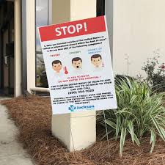
Severe symptoms – emergency warning signs for COVID-19
Most people will have mild symptoms and should recover at home and NOT go to the hospital or emergency room.
Get medical attention immediately if you have:
Difficulty breathing or shortness of breath.
Persistent pain or pressure in the chest.
New confusion or inability to arouse.
Bluish lips or face.
Source: NIEHS
Notes:
Instructor notes:
Source: https://www.cdc.gov/coronavirus/2019-ncov/symptoms-testing/symptoms.html
This list of severe symptoms is not all inclusive. Please consult your medical provider for any other symptoms that are severe or concerning.
The reason to stay away from emergency rooms, hospitals, and family doctors is to avoid spreading SARS-CoV-2 to others. For most healthy people, the illness will be mild, and you can recover at home by drinking lots of fluids and use of over the counter medications. You should also separate yourself from other people at home and practice good personal and environmental hygiene.

Slide 13
Increased risk of severe illness
COVID-19 poses a greater risk for severe illness for people with underlying health conditions not limited to:
Heart disease
Lung disease such as asthma
Diabetes
Suppressed immune systems
Severe obesity
The elderly have higher rates of severe illness from COVID-19. Children and younger adults have had less severe illness and death. Some children have developed multisystem inflammatory syndrome (MIS-C). The cases are currently under investigation. Because COVID-19 is new, there are many scientific unknowns such as the impact on pregnant women and their fetuses.
Source: NIEHS
Notes:
Instructor notes:
As is the case with seasonal flu, certain conditions appear to put some individuals at increased risk of complications associated with COVID-19. These underlying conditions are listed above.
https://www.cdc.gov/coronavirus/2019-ncov/specific-groups/high-risk-complications.html
Early information out of China, where COVID-19 first started, shows that some people are at higher risk of getting very sick from this illness. This includes:
Older adults and people who have serious chronic medical conditions like:
Heart disease
Diabetes
Lung disease
New information from CDC states that some children have developed multisystem inflammatory syndrome and children with underlying medical conditions and special healthcare needs may be at risk for serious illness. There is much more to be learned about how the disease impacts children.
See: https://www.cdc.gov/coronavirus/2019-ncov/faq.html#COVID-19-and-Children
If you are at higher risk for serious illness from COVID-19 , it is extra important for you to take actions to reduce your risk of getting sick with the disease.
NOTE: The rates of infection may be biased higher for older people because we more easily identify infections with severe illness.

Slide 14
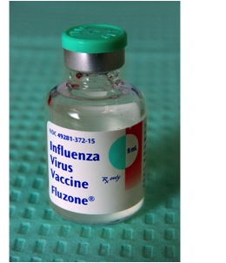
Treatment and vaccines
There is no vaccine to prevent COVID-19.
There is no specific FDA approved medication or treatment for COVID-19.
Treatment is supportive.
People who are mildly ill with COVID-19 should isolate at home during their illness.
Notes:
Instructor notes:
Medical guidelines advise people with mild illness to stay home unless it is an emergency. To reduce the risk of catching or spreading illness, stay home if you feel sick, even if your symptoms are mild. Do not go to work, school or public places, and avoid public transportation. Symptoms should be treated for fever and to prevent dehydration and body aches. Call your health care provider if you develop a high fever, respiratory distress, or other severe symptoms. https://www.cdc.gov/coronavirus/2019-ncov/if-you-are-sick/steps-when-sick.html
If your symptoms are severe or you feel like you need medical care, call before you go to a doctor’s office, urgent care center or emergency room. Describe your symptoms over the phone.
While a vaccine is a central part of the effort to prevent infection and illness, there is no specific antiviral treatment recommended for COVID-19. People with COVID-19 should receive support to help relieve symptoms. For severe cases, treatment should include oxygen supplementation and care to support vital organ functions, as needed.
Unfortunately, viruses such as the coronavirus appear and start spreading before a vaccine is available. With a novel virus, in this case SARS-CoV-2, the population has little or no immunity to the virus.
Even when a vaccine is available, some people will not be vaccinated. Vaccines are tested to ensure that they are safe and effective for most people. However, vaccines normally can have side effects and present significant health risks for vulnerable individuals. Other people who are not considered to be at risk for serious reactions may choose not to receive the vaccine for various reasons.
There is also the possibility that the SARS-CoV-2 virus could mutate, or change over time, which could reduce the vaccine’s ability to prevent infection.
Experimental drugs and vaccines are currently being developed and tested.

Slide 15
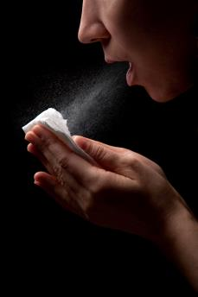
Review: What is Wrong with this Picture?
Poor cough etiquette
No cloth face mask
Notes:
Instructor notes:
The CDC recommends that everyone wear cloth face coverings when leaving their homes, regardless of whether they have fever or symptoms of COVID-19. This is because of evidence that people with COVID-19 can spread the disease, even when they don’t have any symptoms. Coronavirus is a unique virus with unique characteristics.
COVID-19 is transmitted by contact, droplets, and fomites. Public health measures, such as hand hygiene and good respiratory etiquette (coughing into your elbow or into a tissue and immediately disposing of the tissue), are important actions all can take to prevent infection.
https://www.who.int/docs/default-source/coronaviruse/situation-reports/20200306-sitrep-46-covid-19.pdf?sfvrsn=96b04adf_2

Slide 16
Module 2: Assessing the Potential for Exposure to COVID-19 in Daily Activities
Notes:
Instructor notes:
In this module we will address potential exposure to the virus, exposure categories and example exposure settings.

Slide 17
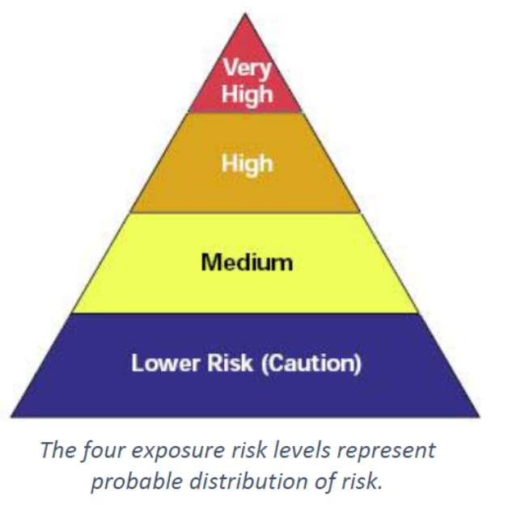
Risk levels during widespread disease transmission
OSHA has published an occupational risk guide for COVID-19 that can be adapted for everyday life.
The risk of community spread of COVID-19 may become less, then rebound or settle into a low level of disease transmission.
Notes:
Instructor notes:
OSHA has published a guidance document that has four different exposure categories: very high exposure, high exposure, medium exposure, and low exposure. The OSHA document: https://www.osha.gov/Publications/OSHA3990.pdf

Slide 18
Conduct a lifestyle hazard assessment
Households range from single occupant to those with 8 or more persons spanning two or more generations. There may be very young, elderly, persons with underlying medical conditions and persons who experience frequent public contact living at the residence. Assess your household characteristics.
Notes:
Risk of infection increases with increasing exposure to the general population and exposure to persons known to have been exposed to a person testing positive for COVID-19 and exposure to persons who are confirmed COVID-19 cases and experiencing symptoms.

Slide 19
Very High Risk of Exposure
A person living in the household who requires care-giving from another family member is ill with COVID-19.
The house does not have an adequate isolation area for the ill person. Ideally, the ill individual can isolate in a bedroom with an adjacent bathroom with a shower or bathtub.
Notes:
Very high risk settings are those with high potential exposure to high concentrations of known or suspected sources of COVID-19 during caregiving for a member of the household. High concentrations of coronavirus could result from activities that generate aerosols from known or suspected sources. An aerosol is a spray or mist that is made up of solid or liquid particles. A person giving care to a symptomatic member of the household who needs assistance with daily living activities such as visiting the toilet, bathing, eating and drinking, personal hygiene etc. is an example.
This exposure scenario assumes that the symptomatic person does not require immediate medical attention.

Slide 20
High Risk of Exposure
A person living in the household is known to have COVID-19 and is exhibiting symptoms.
The house has a separate bedroom with an adjacent bathroom where the ill person can self-isolate.
Notes:
Instructor notes:
There is less risk to other household members living in a household where the symptomatic person can independently provide personal hygiene care during the period of illness and there is a separate bedroom and bathroom for use during isolation. Most COVID-19 cases do not develop serious illness requiring other persons to assist with daily living activities such as visiting the toilet, showering and eating and drinking. Food and water can be delivered to the isolation area by other household members without the need to enter the isolation area.

Slide 21
Medium Risk of Exposure
A person living in the household is informed by their employer or another credible source that they have been exposed to a person with confirmed COVID-19.
A person living in the household works at a job classified by OSHA as low to very high risk of exposure.
A person living in the household routinely leaves the house to participate in activities where people congregate and does not maintain a physical separation of at least 6 feet.
The household routinely allows persons who are not living in the household to enter the house for social visits or business activities.
Examples of places where people congregate are retail stores, restaurants, gyms, places of worship, casinos and similar locations where 10 or more people are present.
Notes:
Instructor notes:
Medium potential for exposure settings are those that have public contact or contact with materials, equipment, or surfaces that may be contaminated. This category reflects an understanding that the virus may be transmitted by people who have no symptoms. Some people with symptoms may also ignore public health warnings about self-isolating or may have little or no support for obtaining necessary goods and services.
Low potential exposure occupations are those that do not require contact with people known to be infected with the coronavirus, nor frequent close contact with the public, for example office workers or construction workers. However, in communities with widespread infection, any congregate setting may be affected.

Slide 22
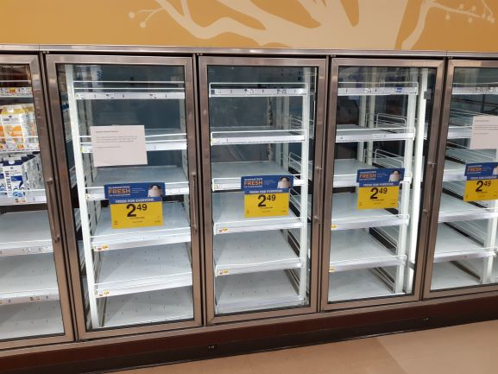
Low Risk of Exposure
All persons living in the household stay at home except for infrequent (one time per week) visits to a grocery store to purchase food and essential household items.
All persons living in the household maintain at least six feet of separation from other persons when outside the house for any reason.
All members of the household agree to not invite any person into the house who is not a permanent resident of the household. And, no external person enters the house for any reason.
Notes:
Instructor notes:
Low potential exposure settings are those that do not require contact with people known to be infected with the coronavirus, nor frequent close contact with the public. However, in communities with widespread infection, any congregate setting may be affected.
Any close contact (less than 6 feet) with a person who is not a member of the household is considered a hazard that should be avoided.
Studies of droplet and aerosol dispersion from a person who is talking, not coughing or sneezing, show that the particles can travel more than 6 feet. This means there is always a slight chance of infection when leaving the house to go to a congregate setting such as a grocery store.
This scenario assumes all household members share each others’ germs, but not the COVID-19.
Photo by Al Brown

Slide 23
Review
Can a household/lifestyle exposure change from low to medium or high exposure?
Yes
Give an example.
A member of the household who has been strictly observing the stay-at-home order begins going daily into places where people congregate and does not maintain a minimum of six feet of physical separation from members of the public.

Slide 24
Module 3: Methods to Prevent COVID-19 for you and your family.
Notes:
Instructor notes:
In this module we address household preparedness, basic hygiene and social distancing, key elements of a household plan, decontamination, use of personal protective equipment and key prevention methods.

Slide 25
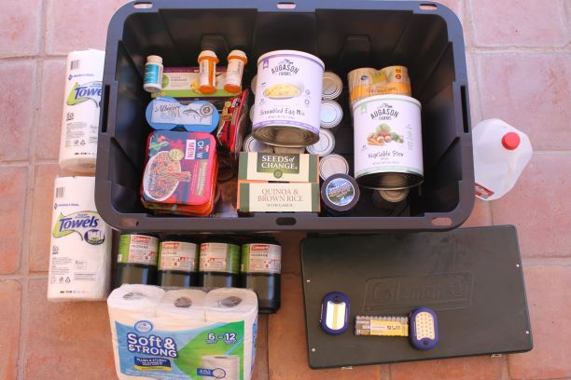
Prepare and Plan for an Extended Emergency
Emergencies happen! Every household needs a plan and must prepare for any plausible emergency, including the ongoing COVID-19 pandemic.
The plan should emphasize maintaining continuous communication with all household members. This includes a backup plan if cell phone communication is temporarily unavailable.
The plan should include stockpiling essential supplies for independent living for at least one week. Including food, water, medications.
Assume that the emergency response agencies will not provide essential living needs for at least one week.
Some emergencies affect water, electricity, transportation fuels and home heating and cooking fuel. Plan for extended outages.
Notes:
Instructor notes:
All of us should learn from the on-going COVID-19 pandemic. We must realize it has not ended. Much remains unknown about the disease. There is uncertainty about possible rebound of cases, seasonality, and variation of the organism that may or may not occur. In Arizona, the percentage of positive tests and hospitalizations has increased since May 15, 2020. Community spread remains widespread and significant as of June 15, 2020.
Assess and recognize the plausible extended emergencies that may affect your community.
Extreme weather events may occur. Flooding, snowstorms, wind, and drought may disrupt the community. All of us are vulnerable to the effects of a cyberattack or extended power outage. Consider whether your water supply and cooking fuel source will be affected.
Advice is available from your local emergency management agency and the Red Cross at: https://www.redcross.org/get-help/how-to-prepare-for-emergencies.html
Photo by Al Brown

Slide 26
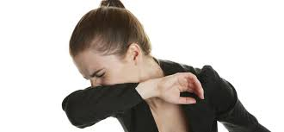
Basic hygiene and social distancing
Stay home when sick, especially if you have a fever.
Wash hands or use sanitizer frequently and after coughing, sneezing, blowing nose, and using the restroom.
Avoid touching your nose, mouth, and eyes.
Cover coughs and sneezes with tissues or do it in your sleeve.
Dispose of tissues in no-touch bins.
Avoid congregate settings if you are a more vulnerable person.
Avoid shaking hands.
Source: NIEHS
Notes:
Instructor notes:
Regardless of exposure potential, there are several steps that everyone can take to lower the chances of becoming sick or spreading COVID-19.
Stay home if you are sick.
Wash your hands frequently with soap and water for 20 seconds or use hand sanitizer if soap and water are not available.
Avoid touching your nose, mouth, and eyes.
Cover your coughs and sneezes with a tissue, or cough and sneeze into your upper sleeve. Wear a face covering.
Dispose of tissues in no-touch trash receptacles.
Wash your hands or use a hand sanitizer after coughing, sneezing, or blowing your nose.
Vulnerable persons include greater than 64 years of age; underlying medical conditions; excess obesity and more.
Avoid shaking hands and always wash your hands after physical contact with others.
CDC guidance: Social Distancing: https://www.cdc.gov/coronavirus/2019-ncov/prevent-getting-sick/social-distancing.html
CDC guidance: Visiting Parks and Recreational Facilities: https://www.cdc.gov/coronavirus/2019-ncov/daily-life-coping/visitors.html

Slide 27

STOP shaking hands!
Notes:
Instructor notes:
You can greet someone and still maintain social distance of six feet or more.
Image courtesy of NUS University of Singapore, Yong Loo Lin School of Medicine

Slide 28
Prevention in all settings
Wash hands often.
Keep common surfaces such as telephones, keyboards clean.
If working, eliminate group meetings by using phone, email, and avoid close contact when meetings are necessary.
Consider telework.
Prohibit unnecessary visitors to the household, including other family members who are not living at the household.
Maintain your physical and emotional health with rest, diet, exercise, and relaxation.
Notes:
Instructor notes:
Household Checklist by CDC: https://www.cdc.gov/coronavirus/2019-ncov/daily-life-coping/checklist-household-ready.html?CDC_AA_refVal=https%3A%2F%2Fwww.cdc.gov%2Fcoronavirus%2F2019-ncov%2Fcommunity%2Fhome%2Findex.html

Slide 29
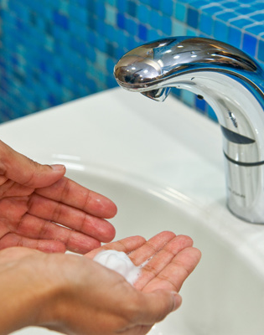
Five steps to proper handwashing
Wet your hands with clean, running water (warm or cold), turn off the tap, and apply soap.
Lather your hands by rubbing them together with the soap. Lather the backs of your hands, between your fingers, and under your nails.
Scrub your hands for at least 20 seconds. Need a timer? Hum the “Happy Birthday” song from beginning to end twice.
Rinse your hands well under clean, running water.
Dry your hands using a clean towel or air dry them.
Notes:
Instructor notes:
Handwashing is important because germs such as virus, get onto your hands when you cough, sneeze, blow the nose, shake hands, use the toilet, and touch surfaces touched by other people. The germs are easily transferred into your body by touching your eyes, nose, and mouth.
CDC: When and How to Wash Your Hands, https://www.cdc.gov/handwashing/when-how-handwashing.html
Activity: Ask the participants if anyone is having a birthday today? Then ask the participants to dry wash their hands while singing happy birthday twice to that participant.
The next slide has an optional 1:25 second video from Johns Hopkins University demonstrating proper handwashing.

Slide 30

Hand washing steps
Handwashing video
Notes:
Instructor notes:
Johns Hopkins University video “Hand Washing Steps, Using the World Health Organization Technique”.
This is an optional video that runs for 1 minute and 25 seconds.
Note: the use of the video is optional, depending on time available to conduct the training.

Slide 31
Decontamination
Households should develop site specific decontamination procedures.
If a person testing positive for COVID-19 is present, more frequent cleaning and disinfection of surfaces must occur.
Use of an EPA registered disinfectant is recommended.
Strictly follow the label instructions.
EPA List: https://www.epa.gov/pesticide-registration/list-n-disinfectants-use-against-sars-cov-2
Notes:
Instructor notes:
The CDC guidelines include disinfecting immediately any visibly contaminated personal protective equipment (PPE), surfaces, appliances, or patient care area surfaces using an EPA-registered disinfectant wipe. They also recommend performing regular cleaning and disinfection of patient care area surfaces, even absent visible contamination. If caring for an infected person in your house, provide the disinfectant wipes to the infected person and instruct them on how to safely use the wipes. All persons handling disinfectant wipes should immediately wash their hands after touching the wipes.
See: https://www.epa.gov/pesticide-registration/list-n-disinfectants-use-against-sars-cov-2
CDC guidelines for household settings: https://www.cdc.gov/coronavirus/2019-ncov/community/home/cleaning-disinfection.html#routine-cleaning
Cleaning refers to the removal of germs, dirt, and impurities from surfaces. Cleaning does not kill germs, but by removing them, it lowers their numbers and the risk of spreading infection.
Disinfecting refers to using chemicals to kill germs on surfaces. This process does not necessarily clean dirty surfaces or remove germs, but by killing germs on a surface after cleaning, it can further lower the risk of spreading infection.

Slide 32
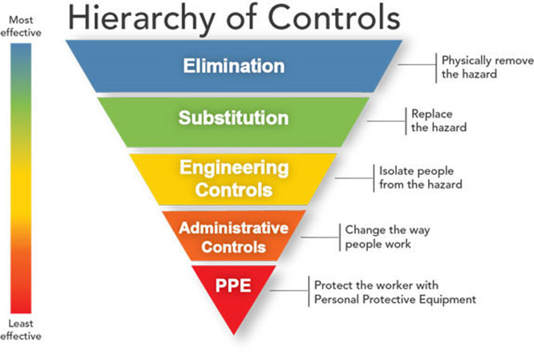
Protecting household members
Start with the most effective method to protect residents.
Physically remove the hazard
Replace the hazard
Isolate people from the hazard
Change the way people work
Protect the worker with Personal Protective Equipment
Source: NIEHS
Notes:
Instructor notes:
As with most any hazard, there are a variety of steps that can reduce or in some cases even eliminate exposure. A basic principle of safety is to use a combination of strategies to protect residents, starting with the most effective. This approach of moving from most effective to least effective protective measures is called the ‘hierarchy of controls.’
The order of controls, from most effective to least effective is:
Elimination
Substitution
Engineering controls
Administrative Controls & Work practices
Personal protective equipment
Source: NIOSH/CDC https://www.cdc.gov/niosh/topics/hierarchy/default.html
This webpage also provides a more thorough definition of each type of control measure.
Transition: We will now review the overall process for selection and implementation of safeguards and review a few measures that should be used in all households.

Slide 33
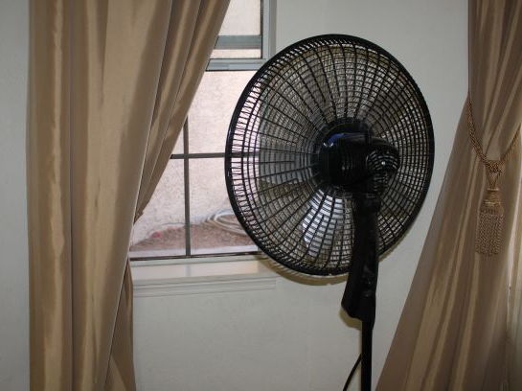

Engineering controls
Ventilation
Isolation room and bathroom
Plastic shields and other barriers
Notes:
Instructor notes:
Engineering controls involve making changes to the home environment to reduce hazards. These types of controls are preferred over others because they make permanent changes that reduce exposure to hazards and do not rely on caregiver behavior. By reducing a hazard in the household, engineering controls are often very effective, and can be cost-effective solutions to implement.
Examples of engineering controls include:
Using enhanced ventilation to remove hazards from the air. Open windows, use fans etc. to disperse and exhaust droplets and aerosols.
Installing physical barriers, such as a shower curtain, or other divider when sharing the same space with an ill person.
Photos by Al Brown

Slide 34
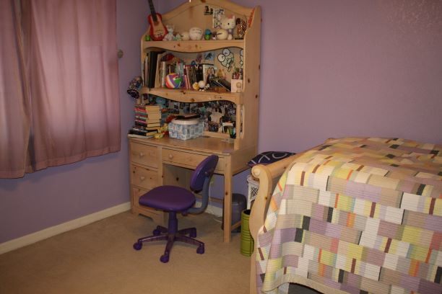
Other examples of household engineering controls for COVID-19
Put a small table and chair in the isolation room for reading, eating and drinking etc.
Set up outdoor living space for well members of the household. Weather permitting.
Notes:
Instructor notes:
A room with a small desk also gives the person in isolation a place to sit while reading, eating using the computer etc.
Photo by Al Brown

Slide 35
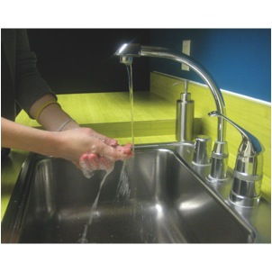
Change household practices and procedures to reduce exposure
Encourage frequent handwashing.
Establish stay at home home policy
Write a list of new household practices and procedures. Post the list on a wall.
Do not allow persons other than household members to enter the house
Train all household members on the new practices and procedures.
Source: NIEHS
Notes:
Instructor notes:
CDC guidance: https://www.cdc.gov/coronavirus/2019-ncov/daily-life-coping/at-home.html
Household practices and procedures (administrative controls) include measures to reduce the length, frequency or intensity of exposure to a hazard. Households should:
Provide a living space that promotes personal hygiene. For example, supply tissues, no-touch trash cans, hand soap, hand sanitizer, disinfectants, and disposable towels for household members.
Develop procedures to minimize contacts between a symptomatic person and other household members.
Cancel in-house services during the period of widespread community disease transmission.
Train and remind all household members about the pandemic period household practices and procedures.

Slide 36

Monitor health status of all household members
Use temperature/symptom checks every day if there is a person who has tested positive living in the house.
Train all household members on symptom checking.
Use separate thermometers or clean and disinfect in between uses.
Notes:
Instructor notes:
https://www.azdhs.gov/preparedness/epidemiology-disease-control/infectious-disease-epidemiology/index.php#novel-coronavirus-what-everyone-needs

Slide 37
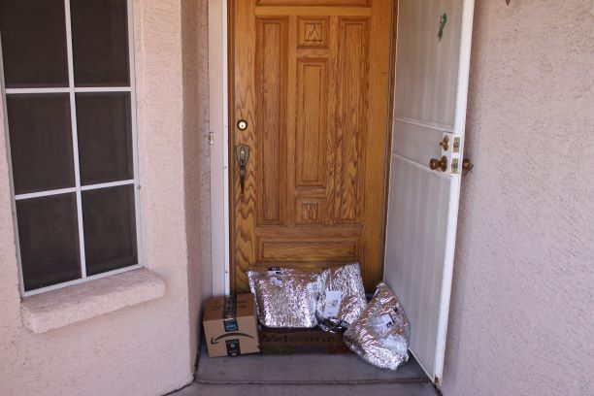
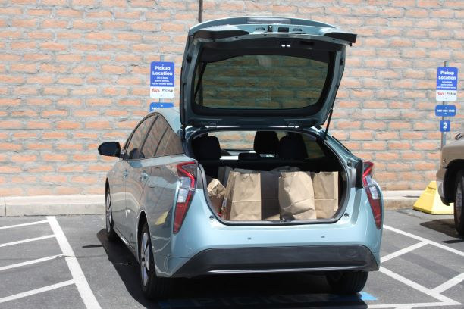
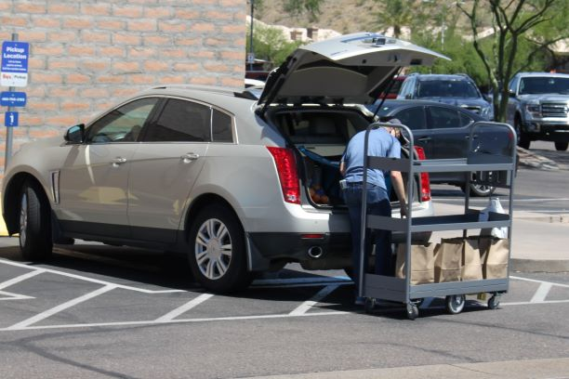
Minimize public contact when outside the home
Order food and other supplies to be delivered to the house.
Order food and other supplies for pick-up outside the store.
Always maintain at least 6 feet of physical distance from others when outside the house.
Do not touch a pet from another household.
Notes:
Instructor Notes:
CDC Guidance on Running Essential Errands:
https://www.cdc.gov/coronavirus/2019-ncov/daily-life-coping/essential-goods-services.html
Photos by Al Brown

Slide 38

Donning and doffing PPE
Source: National Institute of Allergies and Infectious Diseases

Slide 39
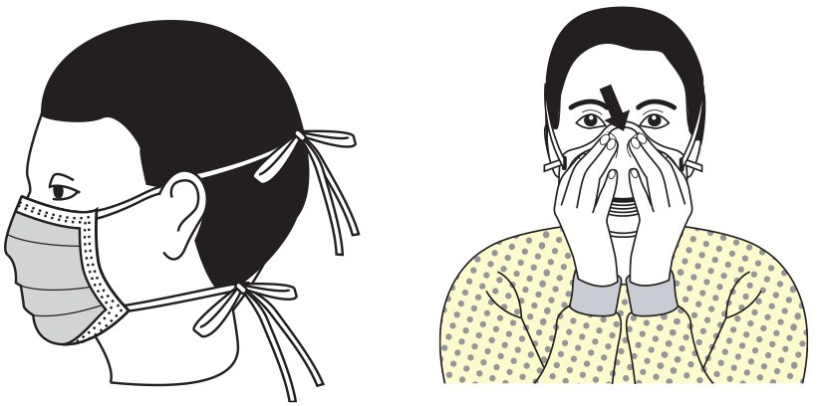
Donning and doffing of PPE
Donning and doffing is the practice of putting on and removing personal protective equipment.
Donning refers to putting on personal protective equipment.
Doffing refers to removing personal protective equipment.
Image: CDC

Slide 40
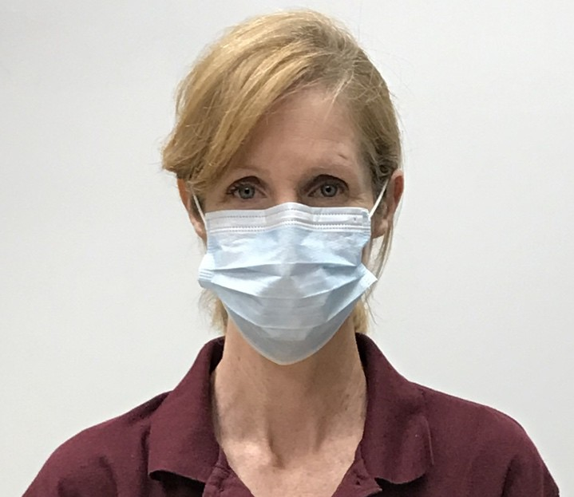
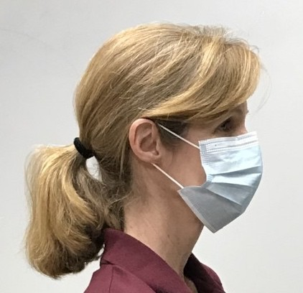
Donning a surgical mask or cloth face mask
Wash hands with soap and water or apply hand sanitizer before donning a mask.
Place mask on face with ear loops over ears.
The mask should cover your nose and mouth with no gaps between the mask and your face.
Wash hands with soap and water or apply hand sanitizer.
Avoid touching the mask while wearing it.
Image: ASU
Notes:
Instructor notes:
Due to a nationwide shortage of respirators and surgical masks, the general public should wear hand made cloth face coverings as described on the CDC website.

Slide 41
Doffing a surgical mask or cloth face covering
Wash hands with soap and water or apply hand sanitizer.
Use the ear loops to remove the mask avoiding touching the front of the mask or your face.
If the mask is in good condition and not soiled, you may reuse it.
Carefully place the mask into a clean Ziploc bag, labeled with the user’s name. Avoid compressing the mask. Do not seal the bag.
Wash hands with soap and water or apply hand sanitizer.
Note: If the mask was worn during an encounter with another person who displayed obvious signs of illness, discard of the mask in the trash.

Slide 42
Reusing a surgical mask or cloth face covering
If using a mask and following social distancing practices, the likelihood of the mask being contaminated is very low.
Wash hands with soap and water or apply hand sanitizer.
Remove mask by holding the ear loops.
After removing facemask, visually inspect for contamination, distortion in shape or form. Discard in trash if soiled, torn, or saturated.
Carefully store in an unsealed bag labeled with your name on it.
Wash hands with soap and water or apply hand sanitizer.
Launder cloth face masks.

Slide 43
Demonstration of cloth face cover donning and doffing procedures

Slide 44
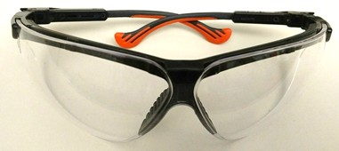
Wearing glasses including sunglasses or reading glasses is recommended
Wash hands with soap and water or apply hand sanitizer before donning glasses.
Remove the glasses from package or storage container.
Photo: ASU
3. Place glasses directly on your face. Do not set the glasses on surfaces.
Image: NIEHS
Notes:
Instructor notes:
Wrap-around safety glasses are best when going into public settings.
It is recommended to wear any type of eye covering you may have.

Slide 45
Procedures for doffing glasses
Wash hands with soap and water or apply hand sanitizer. If wearing gloves, remove gloves before removing glasses.
Remove glasses. Avoid touching your eyes and face.
Clean glasses with soap and water solution. Let dry before storing them.
Place glasses in clean plastic container or Ziploc bag for reuse.

Slide 46
Demonstration of glasses donning and doffing procedures

Slide 47
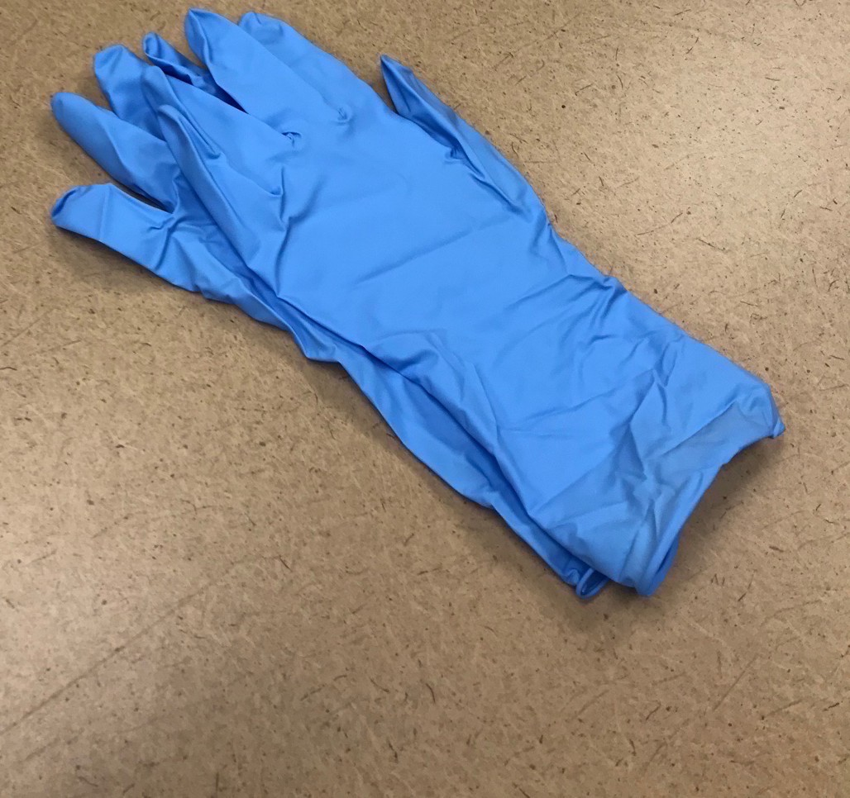
Procedures for donning gloves
Wash hands with soap and water or apply hand sanitizer before donning gloves.
Select properly sized gloves.
Don one glove per hand.
Inspect gloves for any tears or holes and replace gloves if any defects are detected.
Image: ASU

Slide 48
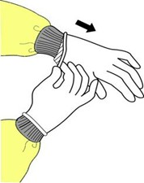
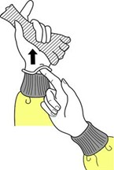

Procedures for doffing gloves
Grasp the outside edge near your wrist.
Peel away from your hand, turning the glove inside- out.
Hold in opposite gloved hand.
Slide ungloved finger under the wrist of the remaining glove.
Peel off from inside, creating a bag for both gloves.
Discard gloves in the garbage.
Avoid touching your face until you wash your hands.
Image: CDC

Slide 49
Demonstration of gloves donning and doffing procedures
Notes:
Videos on how to do it:
mask
https://youtu.be/beejIQmI0MY
gloves
https://youtu.be/xueBYfElFEg
CDC donning and doffing PPE healthcare workers
https://www.youtube.com/watch?v=of73FN086E8&feature=youtu.be
https://www.youtube.com/watch?v=of73FN086E8&feature=youtu.be

Slide 50
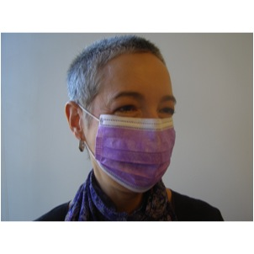
Respirators vs. Surgical Masks
Surgical masks are not respirators!
Surgical masks do not:
Fit tightly against the skin to form a seal
Filter tiny particles, such as viruses or bacteria that are in the air
Source: NIEHS
Notes:
Instructor notes:
Surgical masks are not respirators. Surgical masks are not designed or certified to prevent the wearer from inhaling small airborne hazards, such as viruses, or virus particles. Surgical or procedure masks do not form a tight seal against the user's face. Therefore, when the wearer breathes in, much of the potentially infectious air passes through gaps between the face and the surgical mask. Second, many surgical masks are not made of a material that can filter microscopic particles. Only surgical masks that are cleared by the U.S. Food and Drug Administration and legally marketed in the United States have been tested for their ability to resist blood and body fluids can be used.
Surgical masks are used as a physical barrier to protect employees from hazards such as splashes of large droplets of blood or body fluids. Surgical masks also prevent contamination by trapping large particles of body fluids that may contain bacteria or viruses when they are expelled when the wearer coughs and sneezes.
Surgical/procedure masks are used for several different purposes, including:
Being placed on sick people to limit the spread of infectious respiratory secretions to others.
Worn by health care providers to prevent accidental contamination of patients' wounds by the organisms normally present in mucus and saliva
Worn by employees to protect themselves from splashes or sprays of blood or body fluids; they may also have the effect of keeping contaminated fingers/hands away from the mouth and nose.
Bandannas, neck gators, etc. are not respirators - their use DOES NOT afford any protection to inhalation of airborne droplets containing the virus. However using one of these items may reduce the frequency that people touch their face.

Slide 51
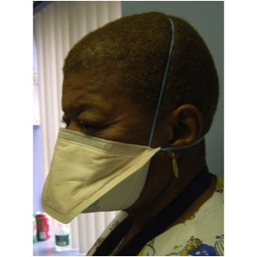
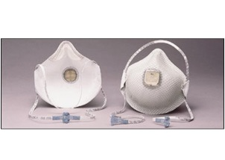
Respirators
Respirators prevent most virus particles from being inhaled. Face coverings and surgical masks do not.
An N95 respirator is the minimum level of protection to prevent inhaling coronavirus.
Due to a respirator shortage respirators are not currently available for the general public.
Source: NIEHS
Notes:
Instructor notes:
Available respirators are currently reserved for healthcare workers, EMTs and other persons working in high risk occupations.
CDC guidance: https://www.cdc.gov/coronavirus/2019-ncov/if-you-are-sick/care-for-someone.html
Respirators are used to prevent breathing in hazards that are in the air. Respirators protect the wearer by either filtering the air before it is inhaled by the worker, or by supplying air from a safe source. Most respirators that protect the worker by filtering the air are designed to fit tightly against the face, and thereby provide a seal between the respirator's edge and the face. When there is a proper seal, the air the worker breathes passes through the respirator’s filter, which captures contaminants. If there is not a tight seal, the air passes through the gaps between the face and the respirator and contaminants are not filtered from the air that the worker breathes.
The National Institute for Occupational Safety and Health, part of the CDC, certifies air purifying respirators, sometimes called particulate respirators, in the following categories based on the resistance to oil, which can reduce efficiency:
N95, N99, N100 - Filters at least 95%, 99%, 99.97% of airborne particles. Not resistant to oil.
R95, R99, R100 - Filters at least 95%, 99%, 99.97% of airborne particles. Somewhat resistant to oil.
P95, P99, P100 - Filters at least 95%, 99%, 99.97% of airborne particles. Strongly resistant to oil.
NIOSH approved respirators will be marked “NIOSH” and the N, R, P categories.

Slide 52

What about CDC’s recommendation to wear cloth face coverings in public settings?
They are not PPE
There is no seal to the face.
Factors like moisture on the cloth may concentrate droplets.
Face coverings will capture or slow some droplets when a person speaks, coughs or sneezes. This reduces risk of exposure but does not eliminate it.
CDC recommends wearing a face covering in settings where social distancing is difficult to maintain.
Source: NIEHS
Notes:
Instructor notes:
https://www.cdc.gov/coronavirus/2019-ncov/prevent-getting-sick/cloth-face-cover.html
On May 16, 2020, CDC revised the guidance on the use of cloth face coverings. Recent studies show the virus can spread between people interacting in close proximity—for example, speaking, coughing, or sneezing—even if those people are not exhibiting symptoms. In light of this new evidence, CDC recommends wearing cloth face coverings in public settings where other social distancing measures are difficult to maintain (e.g., grocery stores and pharmacies) especially in areas of significant community-based transmission.
Other references:
Masks are effective:
https://www.sciencedirect.com/science/article/pii/S2468042720300117?via%3Dihub
https://science.sciencemag.org/content/early/2020/06/08/science.abc6197

Slide 53

Dr. Jerome Adams, Surgeon General
https://youtu.be/tPx1yqvJgf4
Notes:
CDC guidance, printed materials:
https://www.cdc.gov/coronavirus/2019-ncov/prevent-getting-sick/how-to-make-cloth-face-covering.html

Slide 54

Tribal Community Resources
Some tribal communities may be at higher risk due to disparities in access to primary care, food insecurity, multigenerational households, access to running water, access to electricity and more.
Guidance on COVID-19 prevention at workplaces and home published by federal, state and local health agencies is applicable. OSHA standards apply on all tribal lands.
Community level pandemic information may be accessed on the tribal community’s website.
Additional resources for tribal communities published by CDC may be accessed at: https://www.cdc.gov/coronavirus/2019-ncov/community/tribal/index.html
Video:
Notes:
The Navajo Nation has been especially impacted by the COVID-19 pandemic.
Each tribal community in Arizona is sovereign and may choose to apply more stringent epidemic control measures.
For example, the Opening up America guidance may be applied regionally, including at the tribal community level.
Johns Hopkins Center for American Indian Health COVID-19 Materials Developed for Tribal Use:
https://caih.jhu.edu/news/covid19
CDC Guidance on Living in Shared Housing:
https://www.cdc.gov/coronavirus/2019-https://www.cdc.gov/coronavirus/2019-ncov/daily-life-coping/shared-housing/index.html/daily-life-coping/shared-housing/index.html Households Living in Close Quarters:
https://www.cdc.gov/coronavirus/2019-ncov/daily-life-coping/living-in-close-quarters.html

Slide 55
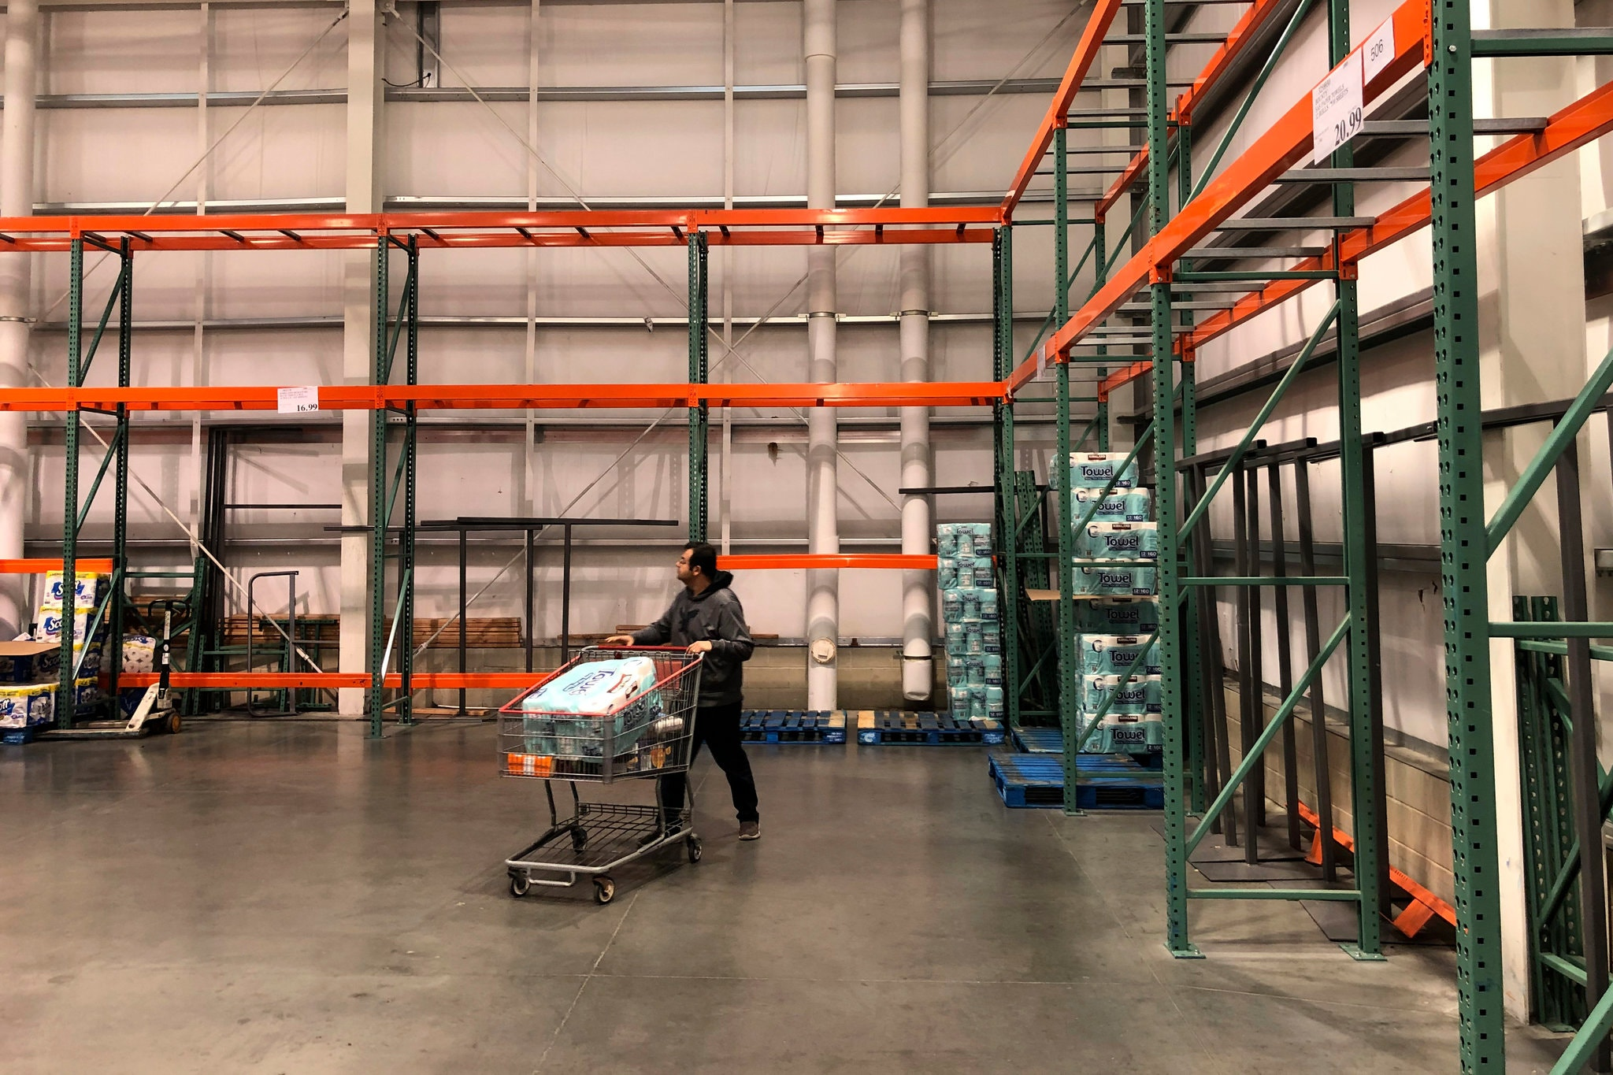
Continuity of Operations (COOP) for all households
All households should have a strategy to overcome potential disruptions to operations for:
communications with household members, including during disruptions to usual services;
stockpiling supplies in the event of a supply chain disruption.
Notes:
Instructor notes:
FEMA Brochure: “What is Continuity of Operations?”
https://www.fema.gov/pdf/about/org/ncp/coop_brochure.pdf
Disaster Management checklist: https://www.paho.org/disasters/index.php?option=com_docman&view=download&category_slug=tools&alias=543-pandinflu-leadershipduring-tool-16&Itemid=1179&lang=en
Cross training is another important step in COOP.
Photo by Al Brown

Slide 56
Notes:
See: https://www.whitehouse.gov/openingamerica/
Three phases of reopening based on public health gating criteria.
The first phase is applicable in States and regions where influenza-like illnesses and COVID-19 have been declining for 14 days and the healthcare system has adequate capacity and testing capability. A limited reopening may proceed.
The second phase is applicable in States and regions with no evidence of a rebound an that satisfy the gating criteria a second time. The reopening guidelines expand the types of places that may reopen and include less restrictive control measures.
The third phase is applicable in States and regions with no evidence of a rebound and satisfy the gating criteria a third time. All types of businesses may open but with limited physical distancing and diligence to hygiene and sanitation.

Slide 57
Notes:
Instructor notes:
This is a decision tool published by the CDC at: https://www.cdc.gov/coronavirus/2019-ncov/community/organizations/workplace-decision-tool.html
Check with state and local health officials to determine the most appropriate actions while adjusting to meet the unique needs and circumstances of the local community.
Compliance with OSHA standards must be considered by the employer. Each workplace is unique. The reopening plan must be site-specific.

Slide 58
Vulnerable persons
Persons who are at higher risk for serious illness due to COVID-19 were discussed in Module 1.
Phases one and two of the Opening Up America Again guidance document advise vulnerable persons to stay at home and continue to avoid public places.
All members of a household with a vulnerable person should continue to stay at home and avoid public places during Phases one and two.
Monitor your state, tribal or local health department webpages to understand and follow the recommendations that are in effect for vulnerable persons.
Notes:
Instructor notes:
As of June 15, 2020, Arizona is in phase one. Some tribal communities remain in pre-phase one status. Check with your local health department.
CDC guidance on going out:
Going out, updated June 12:
https://www.cdc.gov/coronavirus/2019-ncov/daily-life-coping/activities.html
ADHS guidance as of June 15:
https://www.azdhs.gov/preparedness/epidemiology-disease-control/infectious-disease-epidemiology/index.php#novel-coronavirus-what-everyone-needs

Slide 59
Children and Pets
Children do not appear to be at higher risk for COVID-19 than adults.
Children 2 years and older should wear a cloth face covering when in public.
Some children who have tested positive for COVID-19 develop Multisystem Inflammatory Syndrome (MIS-C). Much is unknown about the syndrome. Contact your child’s doctor if your child is showing symptoms of MIS-C. See the link in the notes for this slide.
Do not let pets interact with people or animals outside the household.
Limit contact with pets while sick. Service animals should remain with their handler. Wear a cloth face mask around pets.
Notes:
Instructor notes:
Caring for Children, June 14:
https://www.cdc.gov/coronavirus/2019-ncov/daily-life-coping/children.html
CDC guidance, Tips to Protect Children During a COVID-19 Outbreak: https://www.cdc.gov/coronavirus/2019-ncov/daily-life-coping/children/protect-children.html
CDC guidance, MIS-C: https://www.cdc.gov/coronavirus/2019-ncov/daily-life-coping/children/mis-c.html
CDC guidance, Pets and Other Animals: https://www.cdc.gov/coronavirus/2019-ncov/animals/pets-other-animals.html
ADHS FAQs: https://www.azdhs.gov/preparedness/epidemiology-disease-control/infectious-disease-epidemiology/index.php#novel-coronavirus-faqs

Slide 60
Food Safety
There is no evidence of food, food containers or food packaging being associated with the transmission of COVID-19.
A person who is sick should not prepare food for others in the household.
Always follow the 4 key steps of food safety – clean, separate, cook and chill.
No additional disinfection of food contact surfaces is needed. Be careful not to contaminate food or food contact surfaces when using disinfectants around the house.
FDA issued guidance to retail food establishments re-opening during the pandemic.
Notes:
Instructor notes:
U.S. Food and Drug Administration: FAQs: https://www.fda.gov/emergency-preparedness-and-response/coronavirus-disease-2019-covid-19/coronavirus-disease-2019-covid-19-frequently-asked-questions
FDA guidance for restaurants: https://www.fda.gov/food/food-safety-during-emergencies/best-practices-re-opening-retail-food-establishments-during-covid-19-pandemic

Slide 61
Caring for Someone Sick at Home
People at higher risk of severe illness should call their doctor as soon as symptoms start.
Use the CDC self-checker tool to help you make decisions about seeking medical care. See the link in the notes for the slide.
Limit contact; use a separate bedroom and bathroom if possible; improve ventilation in a shared space; do not share personal items like cell phones.
The sick person should wear a cloth face covering when around the caregiver. The caregiver should wear a cloth face mask.
Clean and then disinfect high-touch areas every day; clean and disinfect a shared bathroom after each use
Notes:
Instructor Notes:
https://www.cdc.gov/coronavirus/2019-ncov/if-you-are-sick/care-for-someone.html
CDC Self-checker tool: https://www.cdc.gov/coronavirus/2019-ncov/symptoms-testing/symptoms.html
CDC guidance on ending home isolation:
https://www.cdc.gov/coronavirus/2019-ncov/if-you-are-sick/end-home-isolation.html

Slide 62
Laundry Guidance When Caring for Someone Sick at Home
Do not shake dirty laundry.
Wear disposable gloves.
You may wash items from all household members together.
Use the hottest water setting.
Wash hands after removing gloves or handling wet laundry.
Dry laundry completely using the hottest setting.
Notes:
Instructor Notes:
CDC guidance:
https://www.cdc.gov/coronavirus/2019-ncov/if-you-are-sick/care-for-someone.html
CDC Self-checker tool: https://www.cdc.gov/coronavirus/2019-ncov/symptoms-testing/symptoms.html

Slide 63
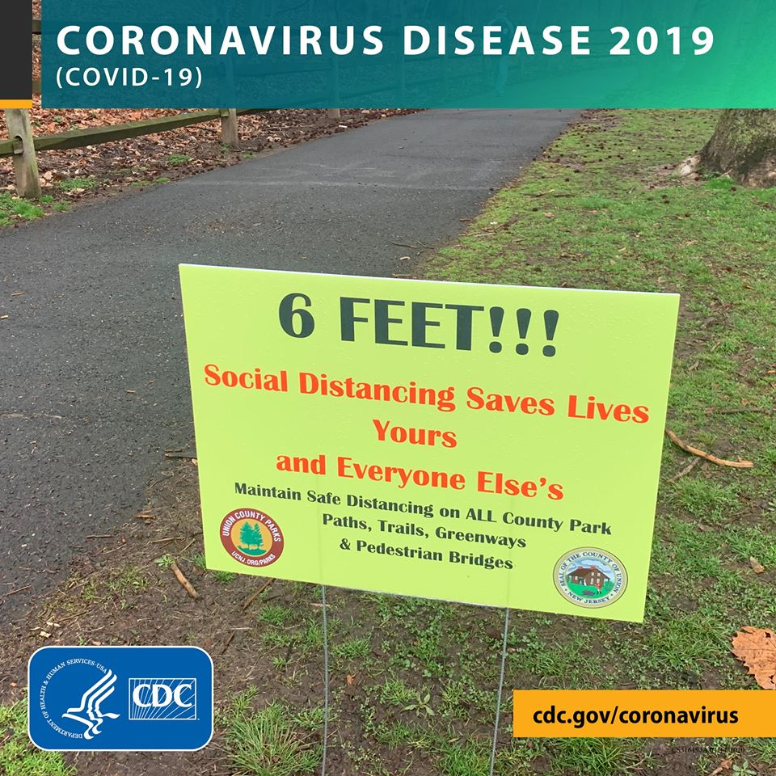
Living in Shared or Congregate Housing
In addition to a household with multiple persons, sharing housing may include apartments, condominiums, academic residential halls and shelters.
These facilities often have shared dining, laundry, recreation, stairways and elevators making is more difficult to maintain adequate social distancing.
Wear a cloth face covering when leaving your private space.
Consider walking in narrow areas like stairways one person at a time.
Maintain 6 feet of social distance in common spaces.
Avoid placing personal items directly on counter surfaces in a shared kitchen or bathroom, especially around the sink. Use totes or plastic bags.
Notes:
Instructor Notes:
CDC guidance: Living in shared housing:
https://www.cdc.gov/coronavirus/2019-https://www.cdc.gov/coronavirus/2019-ncov/daily-life-coping/shared-housing/index.html/daily-life-coping/shared-housing/index.html Households Living in Close Quarters:: https://www.cdc.gov/coronavirus/2019-ncov/daily-life-coping/living-in-close-quarters.html If someone is sick or has tested positive:
https://www.cdc.gov/coronavirus/2019-ncov/if-you-are-sick/care-for-someone.html
https://www.cdc.gov/coronavirus/2019-ncov/if-you-are-sick/index.html?CDC_AA_refVal=https%3A%2F%2Fwww.cdc.gov%2Fcoronavirus%2F2019-ncov%2Fhcp%2Fguidance-prevent-spread.html
CDC Self-checker tool: https://www.cdc.gov/coronavirus/2019-ncov/symptoms-testing/symptoms.html

Slide 64


Are these safeguards adequate?
Notes:
Instructor notes:
Ask participants to name the hazards and safeguards in the photos. Then ask if the safeguards are adequate. If not, ask what would they suggest?
What is the hazard: coming within 6 feet of a contagious customer or coworker or touching a contaminated surface or item.
The signs in the photo let customers know that they are limited to two of each for certain high demand items. Previous features that allowed for high touch self-service have been suspended and use of customers own bags is no longer permitted. Additional signage and markings require 6 feet, social distancing.
Other possibilities: 1) Limit the number of customers allowed in the store. 2) Allow only one-way traffic in the store aisles. 3) Only permit pick up service so that no one enters the store. 4) Provide a minimum N95 fit tested respirator to cashiers and other employees that cannot maintain 6 feet of social distancing.
The floor markings in the photo on the left are used to maintain separation between customers. Will customers comply? If there is no limit on the number of customers, how effective will this approach be? How will the store maintain social distancing when workers are stocking shelves?

Slide 65
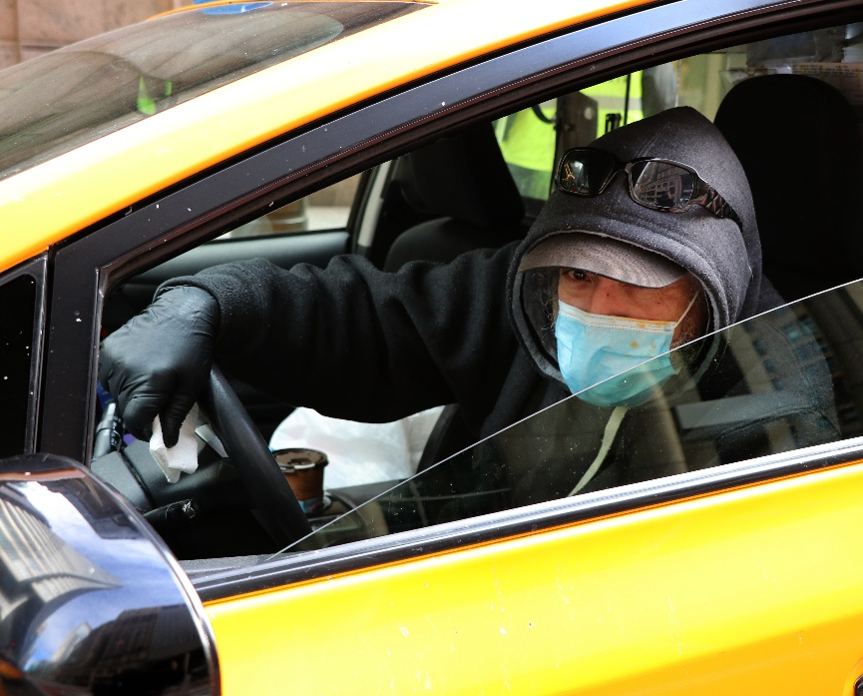
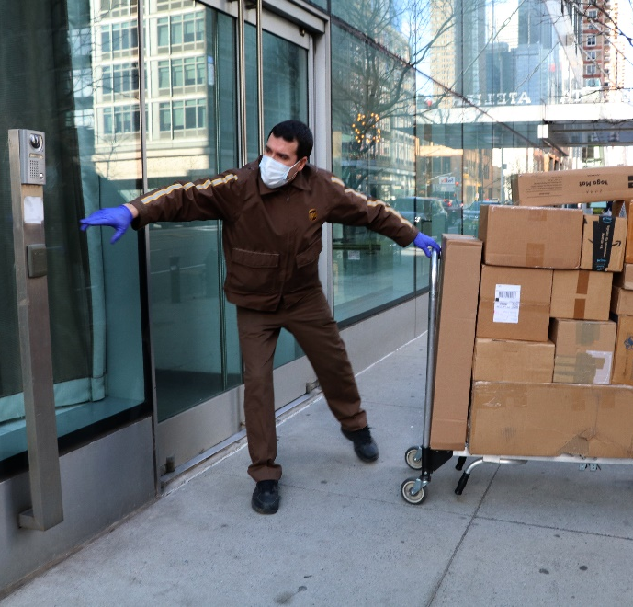
Are these safeguards adequate?
Notes:
Instructor notes:
Ask participants to name the hazards and safeguards in the photos. Then ask if the safeguards are adequate. If not, ask what would they suggest?
What is the hazard: For the cab driver it would include coming within 6 feet of a contagious passenger or touching a contaminated surface or item.
On the right, the hazard is coming within 6 feet of a contagious customer or touching a contaminated surface or item.
The photo on the left by Karen Berman shows a city cab driver wearing a surgical mask and gloves. The photo on the right shows a postal worker making a delivery, donning gloves and a surgical mask.

Slide 66
In conclusion
Thank you for attending today’s program. We hope you benefit from an increased awareness of the methods that can be used to protect yourself and your family members from the COVID-19 virus. Please share these materials with all household members and others who should review the materials.
Notes:
Instructor notes:

Slide 67
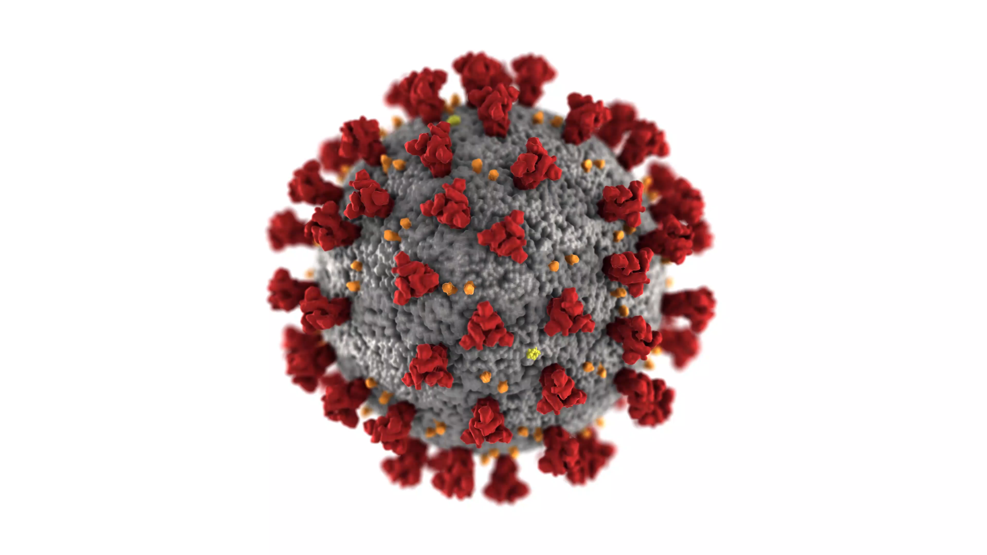
For more information
Centers for Disease Control and Prevention (CDC) http://www.cdc.gov
Occupational Safety and Health Administration (OSHA) http://www.osha.gov
World Health Organization (WHO) http://www.who.int/en/
National Institute for Occupational Safety and Health (NIOSH) http://www.cdc.gov/NIOSH/
NIEHS Worker Training Program https://tools.niehs.nih.gov/wetp/index.cfm?id=2554
Return to work checklist file:///E:/Grants/COVID-19/NIEHS%20files/Return%20to%20work%20workplace_covid_19_checklist_051120_508.pdf
Notes:
Instructor notes:

Slide 68
For more information
U.S. Food and Drug Administration https://www.fda.gov/food/food-safety-during-emergencies/best-practices-retail-food-stores-restaurants-and-food-pick-updelivery-services-during-covid-19
Arizona Department of Health Services https://www.azdhs.gov/preparedness/epidemiology-disease-control/infectious-disease-epidemiology/index.php#novel-coronavirus-home
Arizona Division of Occupational Safety and Health https://www.azica.gov/divisions/adosh
Arizona Chapter Association of General Contractors https://www.azagc.org/
Arizona Public Health Association http://www.azpha.org/
Inter Tribal Council of Arizona https://itcaonline.com/
Arizona State University Environmental Health and Safety
https://cfo.asu.edu/biosafety-program

Slide 69

Thank you!

